Slide 1
Business Interruption

Slide 2
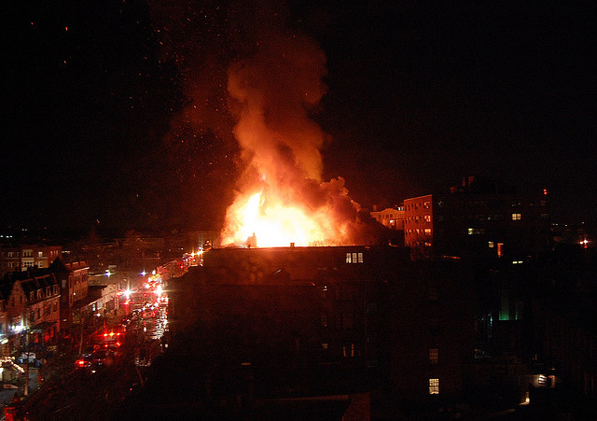
MATERIAL DAMAGE

Slide 3
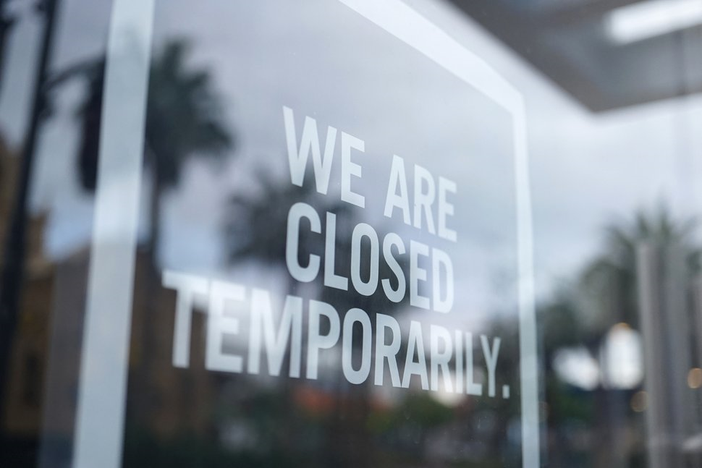
BUSINESS INTERRUPTION

Slide 4
Nomenclature for BI policy
    Different Names of BI
    Consequential Loss
    Loss of Profits
    Business interruption
    Time element losses
    Soft Costs
    Loss of Business Income
    Depending on Underlying Peril Set
    FLOP
    BI section of IAR with MD section perils as underlying
    MLOP
    ALOP
    DSU

Slide 5
Understanding BI
  The BI Policy operates on Principle of Indemnity. It endeavours to put the Client back into Pre loss Position Financially.
  Multiple variants / specifications for fixing up of Sum Insured /Basis of Indemnification available in the market –
    GP –Turn Over( Addition/Difference)
    GP-Output
    Gross Revenue
    Gross Fees basis.
  Gross Profit(Turn Over) & Gross Revenue basis are popular.
  Switching from “ Turn Over” to “ Output” enabled by Alternative basis clause.
  BI applicable for both Mfg- Thermal /Steel / Autos/Petrochemical & Non Mfg Risks – Hotels/SW/
  Occupancy(Petrochem/Non Petrochem) & Continuous/Non continuous nature/ IP used to determine the FLOP Rate but now 100% SFSP Rate.

Slide 6
Understanding BI
Understanding GP : Gross Profit is that portion of Turn Over which is exposed for Loss following an MD event.
Understanding IP: This is the Period during which Insurance payments are made. Indemnity period is chosen by the Insured based on their assessment of Worst case scenario and its the Period during which Insurer pays for Loss of GP – commencing with the Time of Loss and ending with IP or restoration of Pre loss TO – whichever is earlier.

Slide 7
What BI covers
The insurance is limited to loss of Gross Profit due to
    (a) Reduction in Turnover and
    (b) increase in Cost of Working expenditure
    #b is Conditioned by
    necessarily and reasonably incurred
    Sole purpose test
    Economic Limit

Slide 8
Insuring Clause
Subjectivities: Terms and conditions of LOP as well as MD policy- covering the Interest of the Insured at the Premises.
Trigger:if any building or other property or any part thereof used by the Insured at the premises¹ for the purpose of the Business², be destroyed or damaged by the perils covered under the fire policy³, and the Business carried on⁴ by the Insured at the Premises be in consequence thereof interrupted or interfered with.
Material damage (Insurance)Proviso

Slide 9
Business Interruption and Pandemics
  Coverage of BI is examined during Pandemics
  Material Damage proviso – Responds only to direct physical loss or damage
  Can Virus cause physical damage ?

Slide 10
Definitions
Gross Profit = SC+Net Profit / SC-Net Loss } Addition basis
        = (Turnover – UWE) } Difference basis
        =(TO+ Closingg Stock) – (Opening Stock+ UWE) } Difference basis
Notes
This is a Measure of Loss a Business would suffer post a MD incident and hence fixed as Sum Insured in proportion to IP.
This is not the same as an accountant's definition of gross profit - a fact which leads to much confusion and underinsurance. Accountant’s GP does not contain Standing charges and shows the PBT as GP.
The gross profit basis of cover is generally used for manufacturing risks where the business has costs that vary in direct proportion to turnover.
Addition basis – Insured can omit some EXPENSES thinking them as variable to find out that they are SC during the IP.
Difference basis- As WEs are omitted from the TO , little chance of above.

Slide 11
Definitions
Net Profit = Profit before tax
Turn Over =Money paid or payable(or earned) for the Goods/Services done in course of Business. At the premises.
Payments may be made in stages outside the indemnity period even though the work was done within this time. In this situation, unless the additional words "or earned" are added, the policy would not respond.
The actual loss sustained by a business is not the Loss of Turnover, as there are variable costs that are not incurred .
4. Increased cost of working (ICOW): is additional costs spent to maintain the business at pre-loss levels and mitigate the loss of gross profit.
  Sole Purpose Test: expense must be for the sole purpose of avoiding or diminishing the reduction in Turnover. E.g. Air freighting an import of a machine than conventional sea freight , if it saves TO / reduces IP
  Economic Limit: it means that you cannot claim more as an Increased Cost of Working item than was saved by way of reduction in loss of insured gross profit. Capped by ( TO saved x RoGP)

Slide 12
Definition
5. Indemnity Period:The period beginning with the occurrence of the damage and ending not later than the IP selected by the Insured thereafter during which the results of the business shall be affected in consequence of the damage.
IP is chosen by the Insured based on his assessment of max repair period in worst case scenario
IP = Premises Restoration period
IP can be Min 3 Months / max 24 months for Mfg & 36 months for Non Mfg
Effect on Sum Insured: SI has to be AGP for IP of upto 12 months & beyond on Pro rata
Delayed IP- The period beginning with the occurrence of the damage or the interference with the Business.
Leased Premises can pose problems with the restoration as it is in Landlord’s hands.

Slide 13
Definition
6. Standing Charges - Expenses which continue unabated after a MD loss at premises . Insured has to identify the SCs from his P& L account for insurance, which are called ISC.
7. Working Expenses : The Expenses which reduce in direct proportion to the Turn over post loss. That is, if turnover reduces by 50%, the cost reduces by 50% also. No loss results the Insured and need not be insured. Also called UWE.
8. RATE OF GROSS PROFIT :The rate of Gross Profit earned on the turnover during the financial year immediately before the date of the damage.
Formula = GP/TO in %
9. Annual Turn Over/Check for adequacy of SI :The Turnover during the twelve months immediately before the date of the damage.
10. Standard Turn Over :The Turnover during that Period in the twelve months immediately before the date of the damage which corresponds with the Indemnity Period.

Slide 14
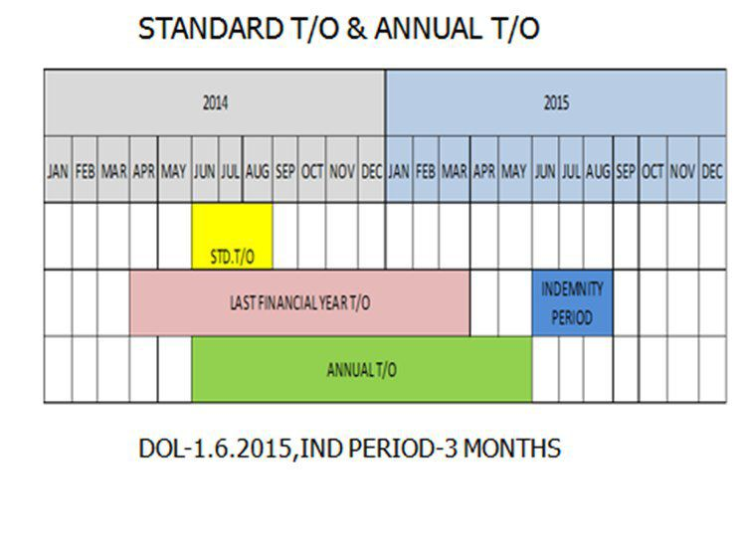
Definition
POI: 01/04/15-16
IP : 3 Months
DOL:01/06/15
IP:01/06/15 to 31/08/15
STO:01/06/14to31/08/14
ATO:01/06/14to31/05/15
Sum Insured is benchmarked to Annual T/O to determine under Insurance

Slide 15
Definition
11. Alternative Trading premises Clause/Turnover Elsewhere After Damage:If Goods are sold / Services rendered from any alternative premises relating to the Insured business during IP – that TO to be accounted in IPTO.
12. Departmental Clause :If the Insured’s business is conducted in departments whose independent trading Results are available Loss of GP due to RTO/ICOW are separately calculated
    E.g. Sugar Mill – Sugar /Distillery/Bio Fertiliser. Clients demand Time Excess also relating to such unit/ production line.

Slide 16
Definition
13. Trends & Special Circumstances clause
The Clause makes the loss calculations flexible , tailoring the numbers to the reality.
Loss will be measured by a formula that will be adjusted to reflect what would have happened to the business results if the clients property hadn't been damaged The “ BUT FOR” Test.
STO/ATO/RoGP are subject to adjustment
Adjustments shall be made as may be necessary to provide for Trend of the business and for variations in or special circumstances affecting the business
either before or after the damage
or which would have affected the business had the damage not occurred
So that the figures thus adjusted shall represent as nearly as may be reasonably practicable the results which, but for the damage, would have been obtained during the relative period after the damage i.e. IP.

Slide 17
Add On Covers in BI
Auditors Fees
Suppliers & Customers Premises Extension
Public Utilities of Electricity/Gas/water Premises Extension
Insured’s Property Stored at other situations
Prevention of Access
Additional Increased Cost of Working (AICOW)
Interdependency or downstream business interruption, when damage at an owned location causes a loss of revenue to another owned location.

Slide 18
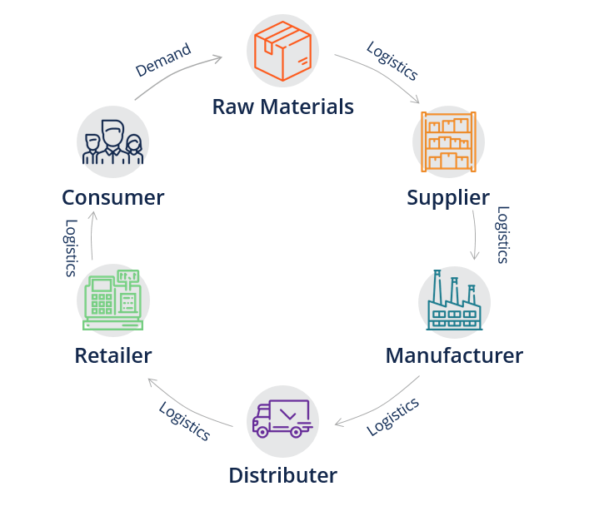
Contingent Business Interruption (CBI)

Slide 19
Additional ICOW
This coverage extends to cover costs and expenses necessarily and reasonably incurred during the indemnity period in consequence of the 'damage' and not otherwise payable under Loss of Gross Profit provision ( increase in cost of working) for the purposes of maintaining the business.
Limit: 10% of Limit of Indemnity (BI Sum insured/ BI Loss Limit) subject to a maximum amount INR 25 Cr

Slide 20
Gross Profit Specification
Loss of GP _{RTO} =(STO-ATO) x RoGP
Loss of GP _{ICOW} =Additional Expenditure sub limited by (TOSxRoGP)
Saving in Standing Charges
Total Loss of GP =(1) + (2) (-3)
Under Insurance application = (4) x (SI/ATO)

Slide 21
FLOP Policy-Problem
Sum Insured = Rs 80 Cr
IP =15 Months
POI =01/04/2017 to 31/03/2018
Date of Loss =15/09/2017
Date of Recovery =14/06/2018 ( Interruption of 9 months)
Standard TO =250 Cr ( 15/09/2016to14/06/2017)
Annual TO =1200 Cr (15/09/2016to14/09/2017 )
PFY TO =1000 Cr
PFY GP =60 Cr
Actual TO –IP =25 Cr
ICOW =50 lacs
Loss avoided –ICOW =8 Cr
Savings in SC =75 Lacs

Slide 22
FLOP Policy- Problem
Solution
(1) RoGP =60/1000 = 6%
(2) Growth Trend =(ATO-PFYTO)/PFYTO %
=(1200-1000)/1000 = 20% This will be the Trends factor
(3) Adjusted STO = 250x120% =300 Cr
(4) Loss of GP due to RITO =(Adj STO-IPTO) x RoGP
=(300-25)x6%
=16.5 Cr
(5) Economic Limit for ICOW =(TO savedx RoGP)
=8x6% = 48 Lacs Less than Actual ICOW.
(6) Payable GP =(4) +(5) – Savings in Standing Charges
=16.5+0.48-0.75
=16.23 Cr

Slide 23
FLOP Policy-Problem
(7) Adjusted ATO for trends = 1200 x 120%=1440 Cr
(8) Sum Required to be Insured(IP=15m) = 1440x6%x1.25=108 Cr
(9) Payable GP adjusted for UI = 16.23x(80/108)=12.02 Cr
(10) Time Excess - 7 days = 7xPer day STOxRoGP
=7 x (250/270)x6%
=0.39 Cr
(11) Final payable FLOP Claim =(9) – (10)
=12.02-0.39
=11.63 Cr

Slide 24
THANK YOU

