Slide 1
Fire Policies

Slide 2
ALL INDIA FIRE TARIFF
Effective 2001 AIFT was released by erstwhile TAC
Salient feature – One risk One Rate
Total Eight (8) Sections
Detariff w.e.f. 01.04.2007
Only Rating detariif
Wording and other T&C still prevalent
W.e.f. 01.04.2021 AIFT applicable for SI > 50 Crs
Below 50 Crs
Bharat Griha Raksha (For Dwellings of any SI)
Bharat Sookshma Udyam Suraksha (SI<5Crs)
Bharat Laghu Udyam Suraksha (SI>5Crs but upto 50 Crs)

Slide 3
Understanding Fire Risk /Perils 12 Perils
Visible flames for Fire to be a insured perils
Excluding –
destruction/damage of property by it’s own fermentation, natural heating or spontaneous combustion
Its undergoing heating or drying process
Burning of property by order of any public authority

Slide 4
Understanding Fire Risk /Perils
Lightning
Explosion /Implosion
Excluding
To Boilers (other than Domestic Boilers), economizers or other vessels , machinery or apparatus (in which steam is generated) or their contents resulting from their own explosion/implosion,
caused by centrifugal forces
Aircraft Damage
Loss, Destruction or damage caused by Aircraft, other aerial or space devices and articles dropped therefrom excluding those caused by pressure waves.
Damage caused during War by Fighter jets?

Slide 5
Understanding Fire Risk /Perils
Riot, Strike, Malicious and Terrorism Damage
Loss of or visible physical damage or destruction by external violent means directly caused to the property insured but excluding those caused by
total or partial cessation of work or the retardation or interruption or cessation of any process or operations or omissions of any kind.
Permanent or temporary dispossession resulting from confiscation, commandeering, requisition or destruction by order of the Government or any lawfully constituted Authority.
Permanent or temporary dispossession of any building or plant or unit or machinery resulting from the unlawful occupation by any person of such building or plant or unit or machinery or prevention of access to the same.
Burglary, housebreaking, theft, larceny or any such attempt or any omission of any kind of any person (whether or not such act is committed in the course of a disturbance of public peace) in any malicious act.

Slide 6
Understanding Fire Risk /Perils
Storm, Cyclone, Typhoon, Tempest, Hurricane, Tornado, Flood and Inundation
Loss, destruction or damage directly caused by Storm, Cyclone, Typhoon, Tempest,Hurricane, Tornado, Flood or Inundation
excluding those resulting from
earthquake,
Volcanic eruption or other convulsions of nature.
(Wherever earthquake cover is given as an “add on cover” the words “excluding those resulting from earthquake volcanic eruption or other convulsions of nature” shall stand deleted.

Slide 7
Understanding Fire Risk /Perils
Impact Damage
Loss of or visible physical damage or destruction caused to the property insured due to impact by any Rail/ Road vehicle or animal by direct contact not belonging to or owned by
the Insured or any occupier of the premises or
their employees while acting in the course of their employment.
Tata Sky Dish damaged by Monkey?

Slide 8
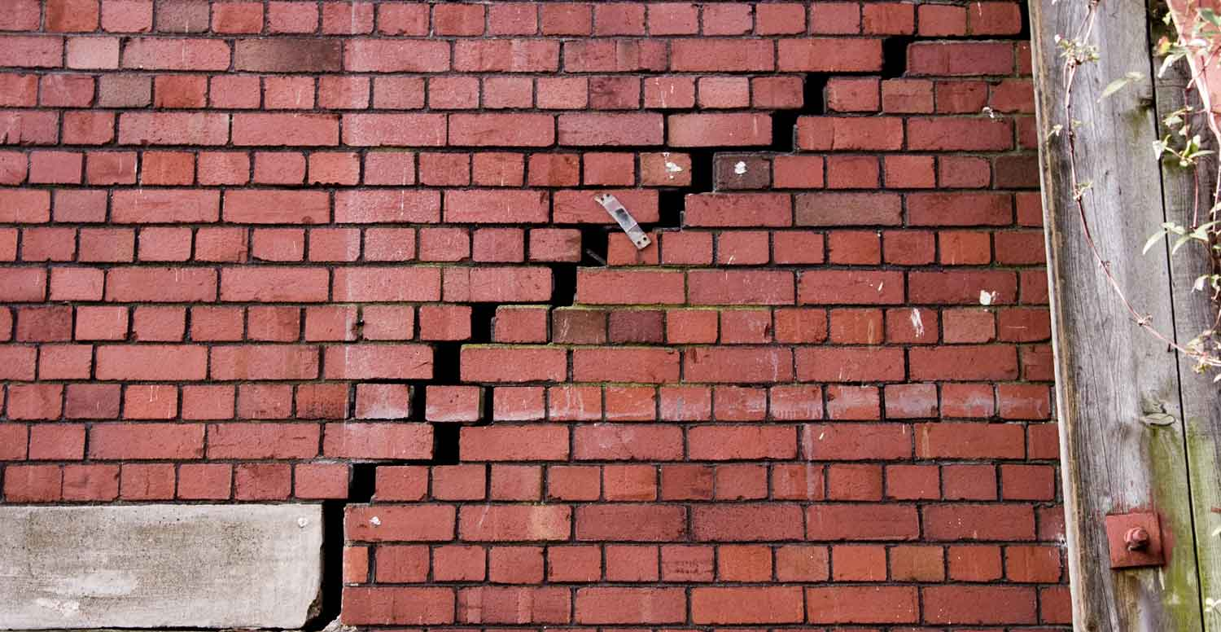
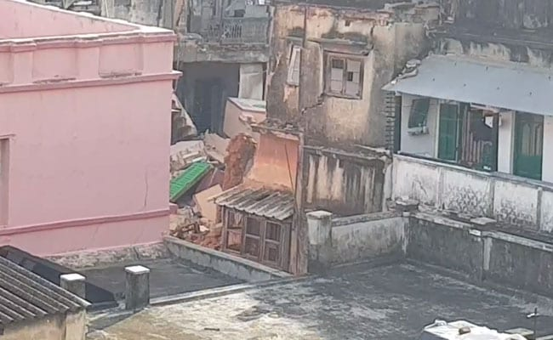
Understanding Fire Risk /Perils
Subsidence and Landslide including Rock slide
Loss, destruction or damage directly caused by Subsidence of part of the site on which the property stands or Land slide/Rock slide excluding:
the normal cracking, settlement or bedding down of new structures
the settlement or movement of made up ground
coastal or river erosion
defective design or workmanship or use of defective materials
demolition, construction, structural alterations or repair of any property or groundworks or excavations.
Kolkata Metro Case Study

Slide 9
Understanding Fire Risk /Perils
Bursting and/or overflowing of Water Tanks, Apparatus and Pipes
Leakage from Automatic Sprinkler Installations
Excluding loss, destruction or damage caused by
Repairs or alterations to the buildings or premises
Repairs, Removal or Extension of the Sprinkler Installation
Defects in construction known to the Insured.
Missile Testing operations ( Can it be covered during War ?)
Bush Fire
Excluding loss, destruction or damage caused by Forest Fire.

Slide 10
GENERAL EXCLUSIONS 13
Excess
Loss, destruction or damage caused by war, invasion, act of foreign enemy hostilities or war like operations (whether war be declared or not), civil war, mutiny, civil commotion assuming the proportions of or amounting to a popular rising, military rising, rebellion, revolution, insurrection or military or usurped power.
Loss, destruction or damage directly or indirectly caused to the property insured by
ionising radiations or contamination by radioactivity from any nuclear fuel or from any nuclear waste from the combustion of nuclear fuel
the radio active toxic, explosives or other hazardous properties of any explosive nuclear assembly or nuclear component thereof

Slide 11
GENERAL EXCLUSIONS
Loss, destruction or damage caused to the insured property by pollution or contamination excluding
pollution or contamination which itself results from a peril hereby insured against.
any peril hereby insured against which itself results from pollution or contamination
Loss, destruction or damage to bullion or unset precious stones, any curios or works of art for an amount exceeding Rs. 10000/-, manuscripts, plans, drawings, securities, obligations or documents of any kind, stamps, coins or paper money, cheques, books of accounts or other business books, computer systems records, explosives unless otherwise expressly stated in the policy.

Slide 12
GENERAL EXCLUSIONS
Loss, destruction or damage to the stocks in Cold Storage premises caused by change of temperature
Loss, destruction or damage to any electrical machine, apparatus, fixture, or fitting arising from or occasioned by over-running, excessive pressure, short circuiting, arcing, self heating or leakage of electricity from whatever cause (lightning included) provided that this exclusion shall apply only to the particular electrical machine, apparatus, fixture or fitting so affected and not to other machines, apparatus, fixtures or fittings which may be destroyed or damaged by fire so set up
Dynamo Clause

Slide 13
GENERAL EXCLUSIONS
Expenses necessarily incurred on (i) Architects, Surveyors and Consulting Engineer's Fees and (ii) Debris Removal by the Insured following a loss, destruction or damage to the Property insured by an insured peril in excess of 3% and 1% of the claim amount respectively.
Loss of earnings, loss by delay, loss of market or other consequential or indirect loss or damage of any kind or description whatsoever.
Loss, or damage by spoilage resulting from the retardation or interruption or cessation of any process or operation caused by operation of any of the perils covered
Loss by theft during or after the occurrence of any insured peril except as provided under Riot, Strike, Malicious and Terrorism Damage cover.

Slide 14
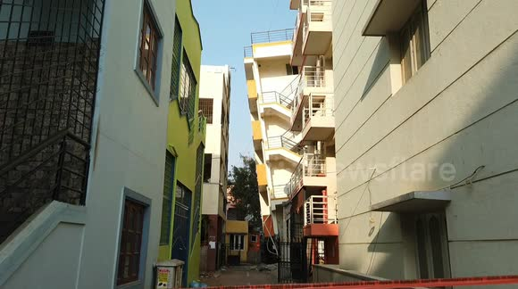
GENERAL EXCLUSIONS
Loss or damage to property insured if removed to any building or place other than in which it is herein stated to be insured, except machinery and equipment temporarily removed for repairs, cleaning, renovation or other similar purposes for a period not exceeding 60 days.

Slide 15
GENERAL CONDITIONS 15
mis-representation, mis-description or non-disclosure
Displacement of any building or part thereof or of the whole
Material Information
unoccupied and so remains for a period of more than 30 days.
Interest of property passes from the insured otherwise than by will or operation of law
Marine policy to act first
Cancellation by notice of 15 days ( pro-rata/short period)
A claim in writing for the loss or damage (Not liable after 12 months)

Slide 16
GENERAL CONDITIONS
After claims , the insurer may
enter and take and keep possession of the building or premises
take possession of or require to be delivered to it any property of the Insured
keep possession of any such property and examine, sort, arrange, remove
sell any such property or dispose of the same for account of whom it may Concern
Policy benefits forfeited if claims are fraudulent
Company at its option, reinstate or replace the property damaged or destroyed

Slide 17
GENERAL CONDITIONS
Underinsurance - Insured shall be considered as being his own insurer for the difference and shall bear a rateable proportion of the loss accordingly
Double insurance
As if uninsured
Arbitration (When the claim goes to court /arbitration?)
Every notice and other communication to the Company required by these conditions must be written or printed.
Operation of Insured Perils
Automatic Reinstatement

Slide 18
Sections of AIFT Section 1 General Rules and Regulation
Policy(ies) should be read together with proposal form(s), schedule, specification, endorsements, warranties and clauses as one contract.
Policy(ies) covering Buildings and/or contents shall show blockwise separate amounts on
(i) Building
(ii) Machinery and accessories
(iii) Stock and Stock-in-Process and
(iv) Furniture and other contents
STFI can be excluded (No selection)

Slide 19
Sections of AIFT Section 1 General Rules and Regulation
Valued Policy(ies) can be issued only for properties whose Market Value cannot be ascertained e.g Curios, Works of Art, Manuscripts, Obsolete machinery
Policies for a period exceeding 12 months shall not be issued except for "Dwellings".
not permissible to grant mid-term cover for STFI and/or RSMD perils
payment of the required additional premium in cash or by draft. This additional premium shall not be adjusted against existing Cash deposits or debited to Bank guarantee
No selection
Cover shall commence 15 days after the receipt of the premium.
The premium rates shall be charged on short period scale on full sum insured at one complex/compound/location covering the entire interest of the insured for the balance period i.e. upto the expiry of the policy.

Slide 20
Sections of AIFT Section 1 General Rules and Regulation
Premium shall be paid in full and shall not be accepted in instalments or by deferred payments in any form.
Minimum premium shall be Rs.100/- per policy except for risks ratable under Section III and „Tiny Sector Industries‟ under Section IV where the minimum premium shall be Rs. 50/ per policy.
Partial Insurance not permissible
a) to issue a policy covering only certain portions of a building. Notwithstanding this, the plinth and foundations or only the foundation of a building may be excluded.
b) to issue a policy covering only specified machinery (except Boilers), parts of machine or accessories thereof housed in the same block/ building.
N.B. Where portions of a building and/or machinery therein are under different ownership, it is permissible for each owner to insure separately but to the full extent of his interest on the building

Slide 21
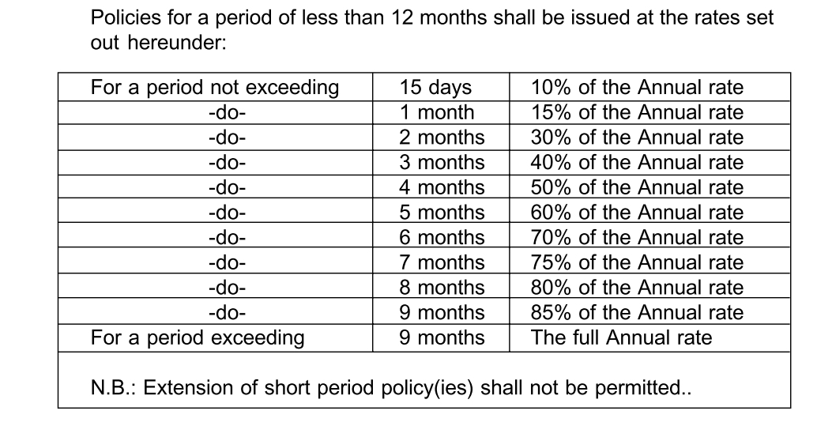
Sections of AIFT Section 1 General Rules and Regulation
Short period policies

Slide 22
Sections of AIFT Section 1 General Rules and Regulation
Loading for Kutcha Construction
Building(s) having walls and/or roofs of wooden planks/thatched leaves and/or grass/hay of any kind/bamboo/plastic cloth/asphalt cloth/canvas/tarpaulin and the like shall be treated as 'Kutcha' construction for rating. An additional rate of Rs.4.00%o shall be charged for such building(s) and/ or contents thereof.
Note:-Temporary sheds (attached to buildings) erected during the monsoon solely for the purpose of monsoon protection are permitted without loading provided such sheds are not used for storage purpose.
RULES FOR CANCELLATIONS
if a policy is replaced with the same insurer by a new annual one covering the identical property, refund of premium may be allowed on pro-rata basis at the original rates for the sum insured replaced.
In case of short period policies, premium shall be retained at the applicable short period scale.
N.B.:- In case a policy is cancelled on account of a Government Order or on completion of a “Building in course of construction” or where Buildings are demolished, pro-rata refund of premium may be allowed.

Slide 23
Sections of AIFT Section 1 General Rules and Regulation
MID-TERM REVISION IN SUM INSURED :
Increase in sum insured : On pro-rata basis
Decrease in sum insured : On short-period scale
ESCALATION CLAUSE
Upto 25% of SI
Additional premium on 50% of the rate on SI selected
Building, Machinery and Accessories only and will not apply to policies covering stock.
Underinsurance will still be applicable

Slide 24
Sections of AIFT Section 1 General Rules and Regulation

Slide 25
Sections of AIFT Section 1 General Rules and Regulation
FLOATER POLICY
issued for stocks at various locations under one Sum Insured
Note: Unspecified locations shall not be allowed.
The rate shall be the highest rate applicable to insured’s stocks at any location with a loading of 10 %.
Presence of “ Kutcha” construction may be ignored.
If stocks situated within godowns/process blocks in the same compound are covered under floater policy, no floater extra is chargeable.

Slide 26
Sections of AIFT Section 1 General Rules and Regulation
DECLARATION POLICIES
issued for frequent fluctuations in stocks/stock values,
The minimum sum insured shall be Rs 1 crore in one or more locations and the sum insured shall not be less than Rs. 25 lakhs in atleast one of these locations.
Monthly declarations based
a) the average of the values at risk on each day of the month or
b) the highest value at risk during the month shall be submitted by the Insured latest by the last day of the succeeding
If declarations are not received within the specified period, the full sum insured under the policy shall be deemed to have been declared.
Refund of premium – 50% of total premium

Slide 27
Sections of AIFT Section 1 General Rules and Regulation
DECLARATION POLICIES
It is not permissible to issue declaration policy in respect of
i. Insurance required for a short period.
ii. Stocks undergoing process.
iii. Stocks at Railway sidings
Underinsurance condition to be applicable
FLOATER DECLARATION POLICIES
Floater Declaration policy(ies) can be issued subject to a minimum sum insured of Rs 2 crores and compliance with the Rules for Floater and Declaration Policies
minimum retention shall be 80% of the annual premium.

Slide 28
Sections of AIFT Section 1 General Rules and Regulation
Discount/Loading for Claims
Also known as Malus / Bonus
Experience (ICR) for past 36 months including expiring period
If there is any break in insurance, available 36 months experience shall be taken into account)
Applicable on all except Dwellings
FEA discount
RATING OF RISKS IN MULTIPLE OCCUPANCY INDUSTRIAL ESTATE
Risks in Multiple Occupancy Industrial Estate shall be rated ‘Per se’.
If the entire building of the Industrial Estate is insured under one sum insured, a rate of Rs. 1.80%o shall be chargeable to ‘building’.

Slide 29
Sections of AIFT Section 1 General Rules and Regulation
SILENT RISK
Risks rateable under Sections IV and V are allowed silent rates
Factories where no manufacturing/ storage activities are carried out continuously for 30 days or more.
Retention of the premium shall be based on the appropriate storage rate or silent risk rate whichever is higher.
Risk should be silent after going operational
Voluntary Deductibles

Slide 30
Sections of AIFT Section III DWELLINGS, OFFICES, HOTELS, SHOPS, ETC., LOCATED OUTSIDE THE COMPOUNDS OF INDUSTRIAL/MANUFACTURING RISKS
'Buildings' and 'Contents' of risks rateable under this Section shall be rated 'per se'.
Stocks in open covered
Incidental operations are permissible
Seasonal storage like crackers with 10% loading allowed
Hazardous goods upto 5% of SI allowed
Utilities rating as per se

Slide 31
Sections of AIFT Section III DWELLINGS, OFFICES, HOTELS, SHOPS, ETC., LOCATED OUTSIDE THE COMPOUNDS OF INDUSTRIAL/MANUFACTURING RISKS
Long Term Discount
a) The policy shall be issued for a minimum period of 3 years.
b) c) Mid-term inclusion of perils shall not be allowed.
d) Premium for entire policy period shall be collected in advance.
No refund shall be allowed if there has been a claim under the policy.
Cancellation within 3 years (normal rates without discount )
Cancellation after 3 years ( as per LTD table)
Method A:
Premium shall be charged in full without any discount. (10% escalation)

Slide 32
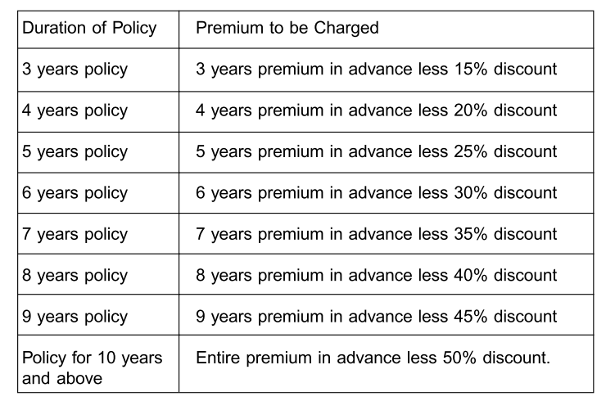
Sections of AIFT Section III DWELLINGS, OFFICES, HOTELS, SHOPS, ETC., LOCATED OUTSIDE THE COMPOUNDS OF INDUSTRIAL/MANUFACTURING RISKS
Method B:
Mid-term increase in sum insured shall be allowed on pro rata basis forthe balance period.

Slide 33
Sections of AIFT SECTION IV INDUSTRIAL/MANUFACTURING RISKS
One risk one rate
Dwellings per se

Slide 34
Sections of AIFT SECTION V UTILITIES LOCATED OUTSIDE THE COMPOUNDS OF INDUSTRIAL/MANUFACTURING RISKS
Rating of utilities as per risk occupancy

Slide 35
Sections of AIFT SECTION VI STORAGE RISKS OUTSIDE THE COMPOUNDS OF INDUSTRIAL/MANUFACTURING RISKS
Buildings/Areas used for storage
packing/selecting/assorting/mending/stitching/battery charging allowe
Presence of hazardous goods not exceeding 5% of the total value of the stocks may be ignored
Incidental open storages upto 2% of sum insured on stock
CATEGORISATION OF HAZARDOUS MATERIALS
Category I < Category II < Category III

Slide 36
Sections of AIFT SECTION VII TANK FARMS/GAS HOLDERS OUTSIDE THE COMPOUNDS OF INDUSTRIAL/ MANUFACTURING RISKS
Associated properties such as Pumping Stations, Compressor House, Blower House etc. shall be rated at par with the rate applicable to respective Gas Holders/ Bullets /Spheres/Vessels/Tanks.

Slide 37
Sections of AIFT SECTION VIII ADD - ON COVERS (14)
Architects, Surveyors and Consulting Engineers Fees ( in excess of 3% claim amount)
Removal of Debris (in excess of 1% claim amount)
(A) Deterioration of Stocks in Cold Storage premises due to accidental power failure consequent to damage at the premises of Power Station due to an insured peril
(B) Deterioration of stocks in cold storage premises due to change in temperature arising out of loss or damage to the cold storage machinery(ies) in the Insured's premises due to operation of insured peril
Forest Fire
Impact Damage due to Insured's own Rail/Road Vehicles,Fork lifts, Cranes, Stackers and the like and articles dropped therefrom

Slide 38
Sections of AIFT SECTION VIII ADD - ON COVERS (14)
Spontaneous Combustion Cat I-IV
Omission to Insure additions, alterations or extensions
Earthquake (Fire and Shock)
Spoilage Material Damage Cover
Leakage And Contamination Cover
Temporary Removal of Stocks Clause
Loss Of Rent clause
Insurance Of Additional Expenses of Rent For An Alternative Accommodation
Start up Expenses

