Slide 1
HR SNAPSHOTS PE 2022

Slide 2
CORE BENEFITS

Slide 3
PAY SCALES CLASS I
Scale VII: Rs.99835-2685(2)-105205-2880(1)-108085-3150(1)- 111235-3265(4)-124295 (6 stages)
Scale VI: Rs.89095-2685(8)-110575 (6 stages)
Scale V : Rs.79605-2300(3)-86505-2590(6)-102045 (6 stages)
Scale IV : Rs.65805-2300(9)-86505 (8 stages)
Scale III :
Rs.53725-1610(1)-55335-1745(6)-65805-2300(4)-75005 (12 stages)
Scale II Rs.44065-1610(7)-55335-1745(6)-65805 (14 stages)
Scale I Rs.32795-1610(14)-55335-1745(4)-62315 (19 stages)
CLASS II
DO Gr I: Rs.23075-1445(8)-34635-1495(9)-48090-1570(2)-51230-1610(4)-57670
DO Gr II: Rs.15650-1030(3)-18740-1175(4)-23440

Slide 4
Stagnation Increments:
An addl. increment payable to an officer
Who has reached the max. of his scale of pay for every 3 completed years of service after reaching such maximum,
Equal to the last increment drawn by him:
Scale I- Maximum of 3 such increments Scale II- Maximum of 5 such increments Scale III- Maximum of 2 such increments Scale-IV and above: NIL
Do Grade I -Maximum of 3 such increments
Sr. Asstt/Steno - Maximum of 6 such increments
For Asstt’s- Maximum of 7 such increments, every 2 years.
For RC and sub-staff: ACPS (Assured Carrier progression scheme) is there.
NB: Stagnation increment is to be released subject to satisfactory performance appraisal and vigilance clearance. Releasing authority is RO in-charge.

Slide 5
PAY SCALES & STAGNATION INCREMENTS OF CLASS III/IV EMPLOYEES
Sr. Asstt./Steno:
Rs.20,210-1445(4)-25,990-1610(15)-50140
Assistant/TYPIST/TELEPHONE OPERATOR/RECEPTIONEST :
Rs.14,435-840(1)-15,275-915(2)-17,105-1030(5)-22,255-1195(2)-24,645-1455(3)-29,010-1510(2)- 32030-1610(5)-40,080.
Record Clerk:
Rs.13,380-580(2)-14,540-620(5)-17,640-665(1)-18305-745(2)-19,795- 820(3)-22,255-915(5)- 26,830-1015(9)-35965.
Driver:
Rs.13,380-580(2)-14,540-600(14)-22,940-665(2)-24,270-745(9)-30,975.
Sub-staff:
Rs.11660-475(5)-14035-505(8)-18075-600(1)-18,675-602(2)-19,915-745(9)-26620.

Slide 6
Based on the All India Average Consumer Price Index for Industrial Workers (In the series 1960 = 100 ) as published in the Indian Labor Journal or the Gazette of India on quarterly basis for every four points rise or fall. Rate of DA: 4708 point-----0.10% of Basic pay
DEARNESS ALLOWANCE

Slide 7
HOUSE RENT ALLOWANCE (HRA)
Sl.No. | Place of posting (1) | Rate per month (ClS I) (2) | Rate per month (ClS II) (3) | Rate per month (ClS III/IV) (4)
1.(A) | Cities of Mumbai, Navi Mumbai, Kolkata, New Delhi, Faridabad, Ghaziabad, NOIDA, Gurgaon, Chennai, Ahmedabad, Hyderabad, Bengalaru, Pune , SURAT TOTAL CITY =13 | 10% of pay subject to maximum of Rs.5,320/- per month | 10% of pay subject to maximum of Rs.5,320/- per month | 10% of pay subject maximum of Rs.5,320/- per month
2.(B) | Cities with population exceeding 12 lacs except the cities mentioned at serial number 1, Gandhinagar and all cities in the State of Goa. TOTAL CITY =30 | 8% of pay subject to maximum of Rs.4,490/- Per month | 8% of pay subject to maximum of Rs.4,490/- Per month | 8% of pay subject to minimum Rs.1000/- & maximum of Rs.4,490/- Per month
3.(C) | All other places | 7% of pay subject to maximum of Rs.4,320/- per month | 7% of pay subject to maximum of Rs. 4,320/-- per month | 7% of pay subject to minimum of Rs.950/- maximum of Rs.4,320/- per month.

Slide 8
CITY COMPENSATORY ALLOWANCE (CCA) 01/08/2012
Sl. No. | Place of posting (1) Metro cities | Rate per month (ClS - I) (3.1) | Rate per month (ClS II) (3.2) | Rate per month (ClS III/IV) (3.3)
1. | Cities of Mumbai, Navi Mumbai, Calcutta, New Delhi, Faridabad, Ghaziabad, NOIDA, Gurgaon, Chennai, Ahmedabad, Hyderabad, Bengaluru, Pune & Surat TOTAL CITIES= 13 | 3% of pay subject to a maximum of Rs.1330/- per month | 3% of pay subject to a maximum of Rs.1125/- per month. | 3% of pay subject to maximum of Rs.1055/- per month.
2. | A class Cities with population exceeding 12 lacs, Gandhinagar and all cities in the State of Goa. TOTAL CITIES: 30 | 2.5% of pay subject to a maximum of Rs.1265/-per month | 2.5% of pay subject to a maximum of Rs.1040/- per month | 2.5% of pay subject to maximum of Rs.990/- per month.
3. | Cities with population of 5 lacs and above but not exceeding 12 lacs, State capitals with population not exceeding 12 lacs, Chandigarh, Mohali, Panchkula, Pondicherry, Port Blair. TOTAL CITIES: 63 All Other Cities C Class | 2% of pay subject to a maximum of Rs.9,80/- per month | 2% of pay subject to a maximum of Rs.910/- per month | 2% of pay subject to maximum of Rs.850/- per month

Slide 9
TRANSPORT ALLOWANCE 01/08/2012
For Class I Rs.1330/- per month
For Class III/IV Rs.460/- per month
DEV.OFFICERS as per their Non-core scheme (SPI-with car/without car)

Slide 10
GRADUATION ALLOWANCE (For Assistants) 01/08/2012
Case – I
Assistant is a Graduate of a recognized University on or after the 1/1/73 but before the 1/8/2007 and not reached the max of the scale, shall be granted two increments in the scale with effect from the publication of results of the examination, or 1st day of the month following the publication of this Scheme, or the date of appointment in the scale of Assistant, whichever is later.
Provided that he has not already received graduation increment or qualification pay for having qualified as such graduate or any advance increment on appointment, otherwise than by way of protection of emoluments for Ex-servicemen.
Provided that if an employee entitled to increments for graduation is drawing Basic Salary of Rs 38470/-, only one increment for graduation shall be granted to him/her.

Slide 11
Case – 2
An employee in the scale of Assistant who has qualified as a graduate from a recognized University before the 1st day of August, 2007 and has reached the maximum of the scale shall be paid revised Graduation Allowance with effect from the 1st day of August, 2012, as per column (2) of the table below :-
Stage | Revised Graduation Allowance per month with effect from 01-08-2012
(1) | (2)
One year after reaching the maximum of the scale | Rs.565/-
Two years after reaching the maximum of the scale | Rs.1000/-

Slide 12
FIXED PERSONAL ALLOWANCE (FPA) 01/08/2012
Sl.No. | Employee in the scale of pay as on 1.11.1993 | Revised F.P.A. (in Rs.)
(1) | (2) | (3)
1. | Scale VII | 3265
2. | Scale VI | 2865
3. | Scale V | 2590
4. | Scale IV/III | 2300
5. | Scale II/I | 1745
6. | Development Officer Gr. I | 1610
7. | Development Officer Gr. II | 1175
8. | Sr. Assistant/Steno/Assistant etc. | 1610
9. | Record Clerk (if already there) | 1015
10. | Driver/Other Subordinate Staff | 745
Note: The revised FPA shall qualify for any benefit such as HRA, PF or terminal benefits including gslip, staff mediclaim. It is applicable only for employees joined the company on or before 01-07-2000.

Slide 13
HILL STATION ALLOWANCE 01/02/2016
Sl. No. (1) | Height of place of posting (Above Mean Sea Level) (2) | Rate for Class I (3) | Rate for Class II (4) | Rate for Class III/IV (5)
1 | 1500 meters and over. | 2.5% of pay subject to a maximum of Rs.765/- per month | 2.5% of pay subject to a maximum of Rs.615/- per month | 2.5% of pay subject to a maximum of Rs.615/- per month
2 | 1000 meters and over but less than 1500 meters. | 2% of pay subject to a maximum of Rs.615/- per month | 2% of pay subject to a maximum of Rs.485/- per month | 2% of pay subject to a maximum of Rs.485/- per month
3 | Not less than 750 meters and surrounded and accessible only through hills with a height of 1000 meters and over | 2% of pay subject to a maximum of Rs.615/- per month | 2% of pay subject to a maximum of Rs.485/- per month | 2% of pay subject to a maximum of Rs.485/- per month

Slide 14
KIT ALLOWANCE wef 01/02/2016
Payable to Class I and III/IV employees if they are transferred to a hill station where HSA is paid.
Rs 6,000/- (One time) for officers and Rs.1500/- for Class III/IV employees.
The Kit Allowance shall not payable:
For transfer from one hill station to another
To Class III/IV employees, if the same was drawn any time during the preceding three years.
Not payable to Dev. Officers Grade I & Grade II.
Paradeep Port Allowance
Rs 185/- per month shall be paid to confirmed employees of all classes and cadres, as long as he/she is posted in the company’s office in Paradeep port.
This allowance shall not be treated as Basic salary for any purpose.

Slide 15
Allowance for Technical Qualifications for Class II & III/IV employees:(01/08/2012)
Sl. No. | Examination | Allowance for Technical Qualification per month (in Rs.)
(1) | (2) | (3)
1 | LIII or LCII AIII or ACII FIII or FCII | 340 925 1550
2 | Institute of Actuaries: On passing each subject | 340
3 | Institute of Chartered Accountants or Cost and Works Accountant: on completion of Intermediate Examination Final Group A or Group B Final Group A & Group B | 665 1135 1550
4 | On completion of MBA from a recognized (by UGC) University or Institution (AICTE Approved course) | 1550 (this is applicable only to Class III & IV employees)

Slide 16
Functional Allowance payable to Class III/IV employees(01/08/2012)
Sl.No. | Cadre-Functions | Amount (in Rs.)
1 | Subordinate Staff engaged in either as Key Holder or for carrying cash to or from Bank, as his regular and main function, where the amount of cash carried during a calendar month is ordinarily Rs.25,000/- or more | 700
2 | Other Subordinate Staff working as Liftmen, Machine Operators, Head Peons, Jamadars, Daftaries, AC Plant Operators and Heavy Vehicle Drivers, who were assigned these functions before 1.1.2006 | 165
3 | Assistant (Sr. Assistant in the event of non-availability of Assistant) engaged in handling cash in an office, as his regular and main function, where the amount of cash transaction during a calendar month is ordinarily Rs.25,000/- or more | 1500
4 | Telex Operators, Punch Card Operators, Unit Record Machine Operators and comptists, who were assigned these functions before 1.1.2006 | 60
5 | Stenographers to CMDs, Scale VII & VI and equivalent positions | 75
6 | Employees performing the functions of Audit Assistants | 850

Slide 17
CONVEYANCE ALLOWANCE TO PH EMPLOYEES
With effect from 01.01.11, payable to Blind and orthopedically handicapped employees of all classes @ Rs.400/- p.m. With effect from 01.08.14, this benefit has been extended to Deaf and Dumb employees also.
An employee shall be eligible for conveyance allowance if he/she has a minimum of 40% permanent/partial disability of either upper or lower limits or 50% permanent/partial disability of both upper and lower limbs together
An employee shall be deemed to be blind & eligible for conveyance allowance when his/her vision is less than 3/60 or field vision is less than 10 in both eyes.
The Conveyance Allowance shall be payable from the date of recommendation of the Appropriate medical authority.
The employees concerned should apply to HO or his/her R.O. through proper channel for the grant of this conveyance allowance.
This Conveyance Allowance shall be payable to all categories of orthopedically handicapped/blind/deaf/dumb employees who are not otherwise eligible for conveyance facilities under any other rules of the Company.
The Conveyance Allowance shall not be payable during any period of leave (except CL), joining time or suspension.

Slide 18
NON CORE BENEFITS

Slide 19
LEAVES (CANNOT BE CLAIMED AS MATTER OF RIGHT—PRIOR SANCTION REQUIRED)
Casual Leave (CL) | 12 days (can avail 5 full days of CL at a stretch & Half day CL {1st half or 2nd half} can be availed max. 6 times in a year). Further intervening holiday{s} & Saturdays/Sundays falling between two CLs would not be counted as CL. 1 day CL without prior sanction can be availed.
Restricted Holiday | 2 days (this can be selected by each employee from a list of Restricted Holidays provided at the beginning of each year.
Earned Leave (EL) | 33.2/11 days (on every 11 working days 1 day accrued) Max. accumulation – 240 days, 270 days w.e.f 13-09-17. It cannot be clubbed with Casual Leave. It can be sanctioned for minimum 6 days and maximum 120 days. Encashment only upto 240 days. 15 days advance application is required.
Sick Leave (SL) | 30 days on half pay basis are accumulated at the end of every year Maximum accumulation – 240 days (h/p). Half day SL only in second half.
Maternity Leave | Maximum 180 days for each confinement, max 2 occasions during entire service period may be allowed to female employees, having less than 3 living children. The spread of leave may be between pre-natal and post-natal periods as per the convenience of the employee.
Examination Leave (For I.I.I. ICAI, ICWAI, CII. | It is granted for the day of the examination irrespective of the examination is in the forenoon or afternoon (max. 2 leaves per paper for III). Cannot be clubbed with SL or ML or QL.
Special Sick Leave | 180 days (half pay basis only) for suffering from any of the major 9 diseases of cancer, leprosy, T.B., paralysis, brain tumor, cardiac ailment, kidney disease, AIDS and mental disease.
Adoption Leave | Maximum two months leave or till the adopted child reaches the age of one year, whichever is earlier, may be granted for adoption of a child through legal process, only once during service career and for one child only.
Paternity Leave | Male employees having less than 2 surviving children, not exceeding 15 days Availed during period of confinement of his wife (15 days before-6mnths after DOD /adoption of child below age of 1 year from date of adoption. Combined with any leave other than CL.

Slide 20
CONJUNCTION/CONTINUATION RULES: (1) Casual Leave in continuation of or in conjunction with Examination Leave, Quarantine Leave or Leave on Loss of pay. (2) Earned Leave in continuation of or in conjunction with Sick Leave, Maternity Leave, Examination Leave, Quarantine Leave, or Leave on Loss of Pay;
(3) Sick Leave in continuation of or in conjunction with Earned Leave, Maternity Leave, Quarantine Leave or Leave on Loss of Pay;
(4) Maternity Leave in continuation of or in conjunction with Earned Leave, Sick Leave, Quarantine Leave or Leave on Loss of Pay;
(5) Examination Leave in continuation of or in conjunction with Casual Leave, Earned Leave, Maternity Leave, Quarantine Leave or Leave on Loss of Pay;
(6) Quarantine Leave in continuation of or in conjunction with Casual Leave, Earned Leave, Sick Leave, Maternity Leave, Examination Leave or Leave on Loss of Pay;
(7) Leave on Loss of pay in continuation of or in conjunction with any other type of leave.
No leave of any kind can be granted to an employee during the notice period while tendering resignation from service or opting for VRS. In case he/she availed leave during notice period he/she may be treated as LOP. However, grant of proportionate casual leave may be considered

Slide 21
SPECIAL LEAVES
Sl. No. | Reason/Purpose | Maximum No. of days that can be allowed | Remarks
1 | For undergoing vasectomy or salpingectomy operation for family planning purpose. | 6 days | Items 1, 2 & 3 are family planning related
2 | To a female employee for undergoing puerperal and non-puerperal sterilization for family planning purposes | 14 days
3 | To a female employee for I.U.C.D. insertion for family planning purposes. | 1 day
4 | For camp duties by employees who have been permitted to join Home Guards Organization. Or Territorial Army | 15 days in a year
5 | For invigilation work at an insurance examination conducted by the Insurance Institutes of India, Mumbai, Chartered Insurance Institute London, Institute of Actuaries, London, and any other bodies conducting insurance examinations, | 3 days at a time subject to a maximum of 7 days in a year
6 | For participation in a representative capacity in a National or an International event in sports; | 30 days | For both these occasions the total limit would be 30 days
7 | For participation as a duly sponsored candidate of the Company in any important local event in sports | 10 days
8 | For willing and fit employees if unable to attend office due to operation of law, e.g., the imposition of curfew either in the area of his residence or in the area where the office is situated. | Actual No. of days

Slide 22
Sl. No. | Reason/Purpose | Maximum No. of days that can be allowed | Remarks
9 | For participation in the Republic Day parade at New Delhi in a representative capacity. | 25 days
10 | For attending conference of III, Mumbai, including the No. of days spent on journey | Actual No. of days
11 | Day of polling, if it is declared as a holiday by the State Government | 1 day | Additional Paid holiday
12 | For casting vote in his/her place of residence, if the date of polling there is different from the date of polling in the place where the office is located | 1 day | Special casual leave
13 | For doing polling duties including journey period, if any | Actual no. of days
14 | For attending Coroner’s Court as jurors if they are required to attend the Court. | Actual no. of days
15 | For the purpose of blood donation at a recognized blood donation centre | 1 day on each occasion, subject to maximum of 10 days in a year | Special leave
16 | For ex-serviceman to appear before the Medical Resurvey board for assessment of their disabilities. | 15 days including journey time, if any

Slide 23
Extra ordinary Leave for joining spouse on Foreign posting
The Board in 359th meeting on 16.10.2015 has approved for extra ordinary leave to employees whose spouse (working in GIPSA member Companies/GIC) is on foreign posting, for the period of such posting of his/her spouse, if no other leave is admissible to him/her. This leave shall be leave on loss of pay.
If leave sought is beyond 180 days, CMD is authorised to grant such leave.
ADVANCE SICK LEAVE:
CMD authority. 180 days H/P. Once in entire carrier. To be adjusted against future SL accrual. For serious illness not covered under 9 major illness. Gen: 50% is LOP and 50% is A SL.
LEAVE FOR LOSS OF PAY:
Max: 3 months in 1 occasion/180 days in entire service. If excess, action under CDA rules. If LOP> 1 month in 1 year, regular increment postponed accordingly. Normal remittance of SGMP/GSLIP will continue from his side..
STUDY LEAVE: CMD sanction. 1 year leave for further studies (1 year extension). Without pay leave . Minimum 5 years of service eligibility.

Slide 24
LEAVE ENCASHMENT
Encashment of EL maximum 15 days may be availed of in a block of two calendar years.
No carry forward of block allowed
Not required to avail 15 days of minimum EL leaves, can avail lesser period. Salary on date on application is payable. It is taxable in hands of employee.
For all Cadres Even to Odd Year i.e. 2022-2023.
CALCULATION (Eligible salary/30 x 15 days)
Class I & II | Class-III & IV
Basic Pay, FULL FPA & all other allowances (DA, HRA, CCA) drawn by the employee are considered EXCLUDING :Officiating/functional allowance, transport allowance & entertainment allowance | Basic Pay, FPA, DA, HRA & CCA are considered All other allowances are EXCLUDED

Slide 25
TA & DA (On Tour over 8 kms from outer ML excl UA limits)
AC II tier train fare, to & fro, for Scale I.
Scale 2 & 3 by Economy class Air fare for surface distance >1000 kms, else 2nd AC.
Scale-4 & above: Air fare –economy class.
Actual Conveyance expenses – residence to Airport, Railway/Bus Station & back, both at Headquarters & place of tour.
Incidental charges – If tour exceeds 12 hr., @ ½ of Halting Allowance applicable to ‘C’ Class cities for each journey i.e. outward & inward for DO and class-I officers only. Otherwise 50% for same day return. (Rs 800 For scale1/2/3).
Deputation: 180 days—full. Then half.
Training: Max: 90 days HA. If no B&L, full rate. If either, 50%. If both-25%.
Where free lodging is provided at the place of halt, ¾ of the Halting Allowance will be admissible. Where free boarding is provided at the place of halt, ½ of the Halting Allowance will be admissible. Where free lodging and free boarding are provided at the place of halt, ¼ th of the Halting Allowance will be admissible.

Slide 26
Officers in Scale II and III will be entitled for air travel while on tour and on transfer, if the distance involved, relating to the said/subject travel, is more than 1000 kms. by surface distance as per the following details :- 1. By Air (Economy Class) provided the air fare does not exceed 125% of the entitled rail (Rajdhani/Duronto Express, if plying on the route) fare, if the distance involved in not exceeding 1000 kms surface distance. In case of travel by Steamer the Officers may travel by the highest class. 2. By Air (Economy Class), if the distance involved is more than 1000 kms.by surface distance. 3. Insurance protection for travel of official tour by Air : 1. Any officer travelling on official duty by Air may be allowed reimbursement of the premium for air insurance cover. This insurance protection cannot be granted to officer undertaking travel by modes other than Air. 2. An officer may, if he so desires, take out at his own cost an annual personal accident insurance, which provides cover for the air journeys to be undertaken on official duty: DGM & above Rs. 5 Lacs Chief Manager / Manager Rs. 3 lacs AO /AM/ Dy. Manager Rs. 2 Lacs.
Millage allowance: Petrol Car: 12% x Petrol rate x Kms
Diesel car: 15% x rate x Kms
Two wheeler: 5% x rate x Kms

Slide 27
In cases where the officers get the facility of guest house accommodation provided by the Company/Government/Public Sector Undertakings or staying with relatives, friends or acquaintance halting allowance will be paid in full. When Boarding and Lodging are provided free by the client to an officer on tour such officer will be allowed 25% of the usual halting allowance admissible to him to cover the incidentals during the period of stay at the place of tour.
In case of stay in Hotel, Halting allowance will be reduced by Rs. 10/- per day. Officers in various grades/scales may be reimbursed the actual hotel expenses, restricting to single room accommodation charges in ITDC Hotels, Subject to the limits (category of hotels) given below :-
Designation of Officer Eligibility to Stay
Scale VII 4 Star AC Single Room
Scale VI 4 Star AC Single Room
Scale V 3 Star AC Single Room
Scale IV 3 Star AC Single Room
Scale III 2 Star Non-AC Single Room
Scale II 2 Star Non-AC Single Room
Scale I 1 Star Non-AC Single Room

Slide 28
In case of Officiating Officiating for officers is allowed for a period exceeding 15 days. Where such officiating arrangement, according to existing rules, is done it would be in order to pay both officiating allowance and travelling and halting allowance admissible to the officers if he has been deputed to hold temporary charge of post in the higher category at a station other than his headquarters.
Treatment of leave on Tour:
CL: No HA during leave period. Return fare is admissible.
SL: No HA during leave period. Return fare is admissible.
EL/PL: Tour comes to an end. No return fare admissible.
Expenses for attending LokAdalat Session
a) The officers may be paid Rs. 1000/- towards reimbursement of out of pocket expenses if they attend the Lok Adalat on Saturdays and Sundays or holidays at the place of posting.
b) If the officer attend LokAdalat at a place other than his/her place of posting, he/she shall be eligible only for TA/HA applicable as on tour as per rules in addition to Rs. 500/- towards reimbursement of out of pocket expenses.

Slide 29
Hotel Charges : 01/01/2013
Hotel Charges | Class IV | Class III | Class II | Scale I | Scale II & III | Scale IV & V | Scale VI & VII | Major cities | Area I
Major cities | 1400 | 1600 | 1800 | 2000 | 2900 | 4800 | 8200 | Ahmedabad, Mumbai, Kolkata Delhi, Chennai, Hyderabad & Bengaluru | Pune, Nagpur, Kanpur, Lucknow, Jaipur, Surat, Vishakhapatnam. Patna, Vadodara, Kochi, Indore, Bhopal, Ludhiana, Coimbatore, Madurai, Agra & Varanasi
Area I | 1050 | 1200 | 1350 | 1500 | 2000 | 2900 | 4100
Other Places | 700 | 800 | 900 | 1000 | 1500 | 2400 | 3600
Standard Breakfast charges along with taxes/surcharges thereon can be allowed during stay in the same hotel. Tips are not reimbursable.
Taxes on hotel charges are allowed on actual basis over & above such charges)

Slide 30
Daily Halting Allowance : (Revised 05/01/2017)
Sl. No. | Category of the employee | A Class City (Rs.) | B Class City (Rs.) | C Class City (Rs.)
1 | Class I (Scale IV, V, VI & VII) | 1300 | 1100 | 950
2 | Class I (Scale I, II & III) | 1100 | 950 | 800
3 | DO Gr. I/ Sr. Asstt./ Stenographer | 700 | 600 | 450
4 | DO Gr. II/ Asstt./Record Clerk | 600 | 520 | 340
5 | All Class IV employees | 500 | 400 | 250
Rs.1800 for Kolkata, Delhi, Chennai & Mumbai (METRO CITIES)-Scale VI/VII Rs. 1500 for Kolkata, Delhi, Chennai & Mumbai (METRO CITIES)-Scale IV/V *Rs.1300 for Kolkata, Delhi, Chennai & Mumbai (METRO CITIES)-Scale I/II/III

Slide 31
Leave Travel Subsidy: Confirmed employees with sanctioned leave only
Current Block – (Two calendar years)
For Class-I – 2021-22 (Odd to Even),Class -II & III/IV – 2020-21 ( Even to Odd)
If not availed during one particular block, the same may be carried forward to the immediate next block e.g. LTS for Block 2017-18 may be availed till 31-12-2020. Subsidy for two blocks together may also be availed.
Individual employee, spouse & all dependent children/parents are eligible to avail LTS. Dependency criteria of dep. is income <=10000. If husband is father is independent, mother is also auto: indep.
Train fare by AC II tier or by Rajdhani or Duronto Express (if actually travelled) up to 3000 Km each way per individual for each block may be reimbursed. Officers in the cadre of Scale IV & above are entitled to Air travel up to 3000 Km each way. Senior citizen discount, infant below 6years etc. as per Indian railways also applicable.
Retention of LTS after Retirement
Extension of period to avail accrued and un-availed LTS upto the date of superannuation for a maximum period of 6 months from the date of superannuation subject to the following conditions :-
Prior intimation of extension of LTS facility.
Prior approval of the Competent Authority before availing LTS facility.
No advance shall be granted.
It shall be subject to relevant provisions of Income Tax Act.

Slide 32
Basic Salary less than Rs. 23450/- will be eligible for 2nd Class Sitting & in case of overnight journey ( 9 p.m to 6 a.m) it will be of Sleeper Class . The distance will remain unchanged
Scale V & above are entitled to AC 1st Class if they travel by it.
A newly promoted AO who did not avail LTS in pre-promoted cadre can avail of the same for un-availed block(s) up to the end of the block period as per his/her previous entitlement. For example, a Cl. III employee who has been promoted to Scale I in 2020 and has not availed LTS for 2018-19 and 2020-21, in the earlier cadre may avail such Blocks till 31.12.21, as per previous entitlement. Thereafter, the promotee would be eligible to avail LTS in AO cadre for 2021-12 and onwards. (HO Pers. Dept. Circular dt. 8.6.2009)
Own Car (plus spouse car) LTS: Petrol expenses plus toll charges. No LTS in company car allowed. No LTS allowed after employee renders resignation.
No foreign LTS is allowed.
For employees posted in North East: When an officer eligible to travel by air undertakes journey by air in full or part LTS journey, the distance covered by air journey shall be the aerial distance of the journey undertaken by him. If he undertakes the balance journey by any other mode, that part of journey shall be calculated as per the surface rail distance and in such cases the actual amount incurred by him on fare will be reimbursed provided such amount does not exceed this fare of the entitled class by train.
iii. However, where the surface distance between the place of origin of journey and the destination is within 3000 kms. but no direct flight is available, the officer shall be allowed travel by the shortest air connectivity available in that sector if in such cases aerial distance does not exceed 3000 kms. This relaxation would apply only to officers who are eligible for LTS by air

Slide 33
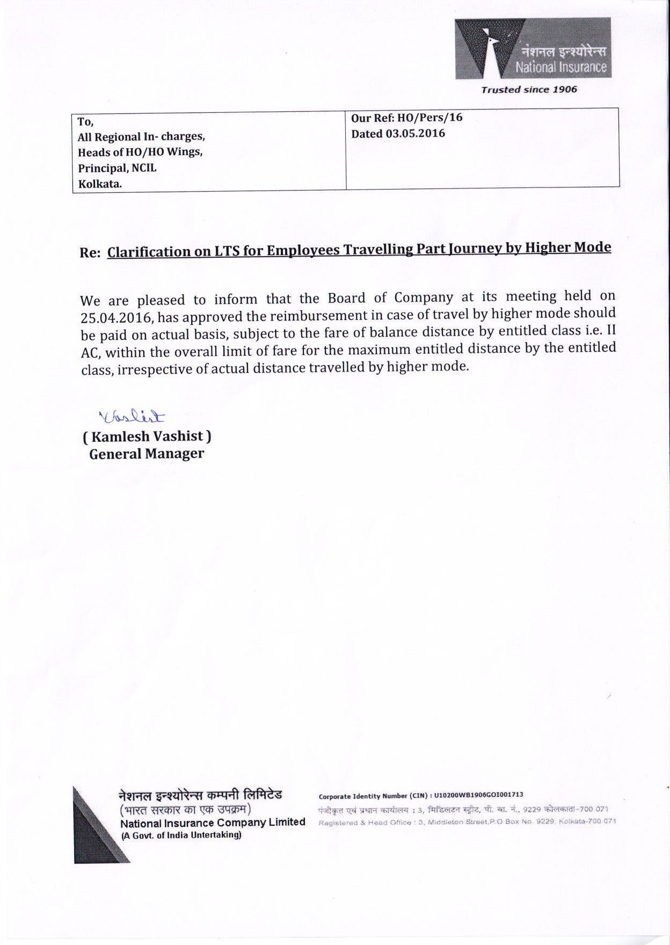

Slide 34
Transfer Benefits for Officers
One month’s basic pay, as on date of taking charge on transfer plus FPA, as transfer grant as on date of taking charge/fixation is higher cadre.
Train/ Air Fare – As per Tour entitlement (If transferred on promotion, this would be as per entitlement in promoted cadre).
Baggage allowance – Rail freight charges for transporting up to 90 (for scale I, II & III) /120 (for scale IV & Above) quintals by Road. By Rail: 40 Qtls/60 Qtls. (Revised)
Ancilliary expenses :
Scale IV and above -Rs.16000/
Scale I,II &III -Rs 12000/
Other than scale I -Rs.8000/-
Joining Leave – 6 days (can be taken in one or two installments). Intervening Saturday/Sunday/Holiday are treated as joining leave. 1 day when no change of residence is involved.
Halting allowance for self plus Family during journey period as per tour rules (C class)
2nd trip for shifting family/household effects within 6 months or start of next academic session of children, whichever is later. GM(P) may further allow extension for another 6 months on receiving such request.
No incidental is payable. GST/S.tax payable over and above entitlement.

Slide 35
Maximum 30 days halting allowance as per tour rules at the new headquarters, if residential accommodation is sought but could not be provided there within 30 days. Excluding time on official tour
No pet/.animal carrying chgs payable.
Transportation of conveyance payable: Road: Mileage allowance
Family includes spouse, legitimate dependent, children, brother, unmarried or widow sister and parents residing with and wholly dependent on the officer.
Time limit: Within 6 months of the date of release from place of transfer or the date of commencement of the next academic year for his children’s education whichever is later.
Self plus spouse transfer: 90 days is considered 1 block.
Baggage Insurance subject to receipt is also payable.
TRANSPORT OF CONVEYANCE
If the conveyance is transported by train or steamer, actual cost of transportation of the conveyance shall be allowed. If it is taken by road :
a) Mileage allowance as per scheme of conveyance facilities shall be allowed to officers who are entitled to conveyance facilities. b) Actual petrol charges by shortest routes shall be allowed to other officers.
MID : ACADEMIC YEAR ALLOWANCE: If an officer is transferred from one place to another in the mid of an academic year and if he has one or more children studying in school or college at the place from where he was transferred and children are left behind to do their education, a mid academic year allowance of Rs.1,150/- per month from the date the officer reports at the later place upto the end of the academic year may be paid. This Rs.1,150/-per month is payable irrespective of number of children.

Slide 36
Company Accommodation
If Company flat is available, the same may be provided according to the existing allotment procedure.
If Company flat is not available, the accommodation on Company lease or Personal Lease (in rare cases) may be considered as per the officer’s entitlement shown in one of the following slides.
6 months adjustable rent advance may be allowed in favor of the Landlord
Deduction from salary: 0.75% of the Basic Pay at the minimum of the scale of pay. HRA will not be paid
As per HO Circular dated 26.02.2016, the transferred officer can retain existing Leased accommodation at previous place of posting entitlement being limited to the lease rent limits at his current place of posting.
If Officers has house at transferred place—given on rent. Subject to sanction, 30 days HA in lieu may be paid for stay in transit.
Within city limits transfer/Local shifting: from company accommodation to company accommodation: 5000/7500/10000. 25%, if shifting within same compound.

Slide 37
Revised Rent Limits for eligible/entitled Officers w.e.f. 01/06/2018 (incl. society maint. Chgs)
 | MUMBAI | Metros |  | A Class Cities |  | B Class Cities |  | C Class Cities
Cadre |  | Existing Limit | Revised Limit | Existing Limit | Revised Limit | Existing Limit | Revised Limit | Existing Limit | Revised Limit
Scale I & II (other than Branch I/C) | 30,000 | 15600 | 20000 | 11700 | 15000 | 7000 | 10000 | 5100 | 8000
Branch Manager | 30,000 | 16400 | 21000 | 12500 | 16000 | 7400 | 11000 | 5500 | 9000
Scale III & IV (other than SDM) | 33,000 | 18700 | 26000 | 14000 | 21000 | 8300 | 14000 | 6600 | 12000
SDM | 33,000 | 20300 | 29000 | 14800 | 23000 | 9000 | 16000 | 7400 | 13000
Scale V | 36,000 | 20300 | 29000 | 14800 | 23000 | 9000 | 16000 | 7400 | 13000
Scale VI | By CMD | By CMD | BY CMD on case to case basis within 125% of applicable limit for scale5
Scale VII | By CMD | By CMD | By CMD | on case to case basis within 125% of applicable limit for scale5

Slide 38
REIMBURSEMENT OF EXPENDITURE ON NEWSPAPER & PERIODICALS FOR CLASS-I OFFICERS
The above expenses shall also be reimbursed on declaration basis for Class-I officers (half yearly basis i.e. on 1st July and 1st January in respect of 1st and 2nd half respectively of the calendar year)
For officers up to Scale III : Rs. 200/- per month
For officers in Scale IV &V : Rs. 400/- per month &
For officers in Scale VI and VII : Rs. 500/- per month

Slide 39
Reimbursement for purchase of Briefcase/Leather Bag to Officers & Development Officers (other than Administration) W.e.f.>>01/09/2014
Sl.No. | Cadre | Limit (in Rs.)
1. | Scale VI & Above | 5000
2. | Scale IV & V | 4000
3. | Scale II & III | 3000
4. | Scale I | 2000
5. | Development Officers (other than Administration) | 1500
Reimbursement may be allowed to all Class Iofficers, including promotees and probationers and all confirmed Development Officers (other than Administration)
The frequency of reimbursement will be once in three years from the date of last reimbursement.
The limit of reimbursement shown above shall be inclusive of sales tax and other Supplementary taxes, if any.
The above limits for Class I officers are effective from 1.09.2014 and that for the Development officers (other than Administration) is w.e.f. 1.4.2009.

Slide 40
VEHICLE LOAN
Two wheeler:
Rs. 75,000/- for Class-I, CL II (Admn) & CL-III & IV (maximum)
No. of installments – 60
Minimum eligibility – 3 yrs. & can be taken 3 time in Class-III cadre & 3 times in Class-I cadre. Once in 7 years.
Reimbursement of comp. Ins. premium by the Company during loan recovery period.
Rate of interest – 5% p.a. on reducing balance.
Four wheeler: MINMUM 5 YEARS SERVICE
Non-entitled (admn) Scale I & Scale II are entitled to this facility up to Rs. 2.5 lacs & such Scale III & IV is Rs.4.5lacs.
No. of repayment installment – 120
Rate of interest – For Scale I & II officers, 5% p.a. on first 1.00 lacs and 7.5% on remaining 1.5 lacs. For Scale III & IV 5% on 4.5 lacs on reducing balance.
Reimbursement of Insurance premium by the Company during loan recovery period on proportionate basis.
Loan amount should be disbursed in such a way that repayment together with the monthly instalment of repayment on account of housing loan, if any, does not exceed 50% of the gross monthly emoluments of the concerned officer in the month in which the loan application is considered for sanction. Further, criteria of minimum net carry home salary i.e. 30% of gross salary need to be complied with.
No RTO/Octroi/Taxes and other charges reimbursable.
No running and maintenance expenses reimbursable.
Sanctioning authority: RO in-charge

Slide 41
Lump sum Domiciliary Medical Benefit
For Officers :
Basic Up to Rs. 58825/- Rs. 13,300/- Payable in December except retirement.
Basic above Rs. 58825- Rs. 19940/- Payable in December except retirement.
For Dev. Officers:
Basic Rs. 46595/- & above Rs. 13,300/- Payable in December
Basic below Rs. 46595/- Rs. 8,310/- Payable in December
For Clerical & Subordinate Staff (advance): Rs. 6650/- Payable in July
Diagnostic Medical Check-up for Officers in Scale-IV and above
The limits of Medical Check-up for Scale-IV and above Officers has been revised from Rs.2000/- to Rs.5000/- per medical check up.
BEFORE 50 YRS—ONE.
50 TO 55 YEARS: TWO
56 TO 60: TWO

Slide 42
Honorarium, Functional Allowance & Conveyance for Officers & Visiting faculties in Training Centres
The Officers working in the Training Centres & visiting faculties are allowed following benefits :
Sr.no Designation /function Allowance per month
1 Principal, NCIL 2000/-
2 Faculty member, NCIL 1200/-
3 Prinicipal, RTC 1000/-
4 ATC In charges 600/-
Payment of Honorarium to In house faculty (for retired employees also) of training Centres is as follows:
1. Officer from our Industry as internal faculties: Rs.500/-(for each session of 90 minutes at NCIL (Corporate Training Centre)
2. Rs.500/- for each session of 90 minutes at RTC/ATC .
Payment of Honorarium to External faculty of training centres is as follows:
1. Rs.1200/- for each session of 90 minutes (Corporate Training Centre)
2. Rs.1000/- for each session of 90minutes at RTC/ATC.

Slide 43
ANNUAL GROUP MEDICLAIM POLICY ON FLOATER BASIS (Revised w.e.f 01.04.2017)
Company's contribution towards premium for serving employees : for employee, spouse and two dependent children – 75% of the premium payable + 18% GST upto the eligible sum insured.
Employees' contribution towards premium for serving employees (All class) 25% of premium payable + 18% GST up to the eligible sum insured.
FTS full by company.
Entire differential premium payable for differential higher sum insured opted by Employee over and above the eligible sum insured for self, spouse and two dependent children + 18% GST.
Entire cost of premium payable for dependent ineligible children and dependent parents + 18% GST.
The entire cost of premium payable for dependent parents-in-law, independent children and their family members (who are already provided coverage under GMC Policy expired on 31.03.2013) + 18% GST.
Notes:
43

Slide 44
Eligible Sum Insured :
Basic+FPA less than Rs.43,300/= - Rs. 5,00,000/=
Between Rs. 43,300/= & Rs. 55,335 - Rs. 6,00,000/=
Rs. 55,336/= and above - Rs. 10,00,000/=
Maximum Optional Sum Insured Rs. 50,00,000/= on floater basis.
Dependant Parents & Parents-in-law after their inclusion, the employee shall not be allowed to exclude any such member except upon his/her death.
Pre existing diseases covered for everyone.
Stay in ICU/CCU/ICCU/Critical Care – Maximum reimbursement limit per day shall be double that of room entitlement.
Service charges levied by hospitals/nursing homes – payable provided levying of such charges is a standard policy followed by the hospitals for all patients.
Notes:
44

Slide 45
Maternity benefits (for two living children) –
Normal Delivery :- Rs.50000/- for A Class cities
Rs.40000/- for other cities
Caesarian Delivery :- Rs. 1,00,000/- for A Class cities
Rs.65000/- for other cities
Maternity benefit shall also be extended to an independent child or a family member of the dependent/independent child.
Room Rent Charges : Actual Room Rent charges per day shall be limited to an amount which is equal to the sum of (a) 1% of SI up to 10 lacs + 0.5% of SI beyond Rs. 10 lacs – for treatment in Hospitals/Nursing Homes located in cities/places categorized under Sl. No. 1 for payment of CCA.
0.75% of SI – up to Rs. 10 lacs + 0.5% + 0.5% of SI beyond Rs. 10 lacs – for treatment in hospitals/nursing homes located in any other place.
The rent limits are subject of capping of Rs.15000/- in Á’Class cities and Rs.12500/- in other cities.
Notes:
45

Slide 46
Increase/decrease in Sum Insured :
Increase in optional SI : The next renewal date in the block years shall fall due on 01.04.2023 (3 years gap).
Decrease in optional sum insured to the immediately lower slab of Sum Insured alone is permitted in the event of decrease in family size on account of death/exist of an insured family member from the Scheme, w.e.f. the next renewal date following the date of event.
Existing/Retired Whole Time Director shall be eligible to get Independent children, Family Members (i.e. Spouse and children) of Independent Children and Dependent Parents-in-law covered under the Policy on Full Premium.
TPA charges for serving the claims are proposed to be absorbed by the Company. TPA fees paid centrally from HO.
Employees should preferably take treatment at Network hospitals.
Notes:
46

Slide 47
Group Personal Accident (GPA):
If any employee sustains injury causing death/disablement, the Company will reimburse the following:-
a) Death | Capital Sum Insured
b) Loss of two limbs, two eyes or one limb and one eye | Capital Sum Insured
c) Loss of one limb or one eye | 50% of the capital Sum Insured
d) Permanent total Disablement from injuries other than those named above | Capital Sum Insured
e) Permanent Partial Disablement | Specified percentage of the Capital Sum Insured depending on the extent of Disablement.

Slide 49
HOUSING LOAN
Revised Scheme Loan & Supplementary Loan are available are as under:
Cadre | Scheme Loan (Int. @ 5% per annum) | Supplementary Loan (Int. @ 7.5% per annum)
Scale VI &above | 36 lacs | 44 lacs
scale IV/V | 33 lacs | 37 lacs
Scale III | 28.75 lacs | 34.25 lacs
Scale I/II | 28 lacs | 32 lacs
Dev. Officer Gr-1 | 21.25 lacs | 28.75 lacs
Dev. Officer Gr II Admn) | 20.75 lacs | 24.25 lacs
Sr. Asstt/ Steno/Asstt. | 20.75 lacs | 24.25 lacs
Record Clerk | 17.25 lacs | 20.75 lacs
Sub Staff | 13.25 lacs | 16.75 lacs
Total Loan
80 lacs
70 lacs
63 lacs
60 lacs
50 lacs
45 lacs
45 lacs
38 lacs
30 lacs

Slide 50
1. ELIGIB ILITY :
All the confirmed employees with three years or more service are eligible for loan for purchase of land and construction of house thereof, purchase of flat/house subject to terms & conditions of the HBL Scheme.
2. EFFECTIVE DATE :-
The effective date for giving such benefit is with immediate effect (HO Circular dated 23.08.2016)
3. RATE OF INTEREST :-
The rate of interest on Scheme Loan will be 5% p.a on reducing balance. In case of Co-operative Housing Society formed with 90% membership of employees from General Insurance Industry, the rate of interest on Scheme Loan will be 4.5% p.a.
The rate of interest on Supplementary Loan will be 7.5% p.a. on reducing balance.
Penal interest for letting out the flat/house/apartment @ 2.5% over and above the rate for Scheme Loan shall be charged if the employee is posted at the same station where the subject property is situated. Further, the rate of interest on Supplementary Loan shall remain unaffected, i.e. no penal interest is to be charged on the amount of Supplementary Loan.
4. ADDITIONAL INTEREST :-
Additional penal interest @3% on outstanding Scheme as well as Supplementary loan would be added after all the above calculations in case the Employee Borrower is not in possession of the mortgaged property /fail to furnish the let-out declaration/fire insurance policy/LI premium on mortgaged policy and default in payment of EMI.
As per past practice, after revision in the limits of Housing Loan, conversion of Suppl. Loan into Scheme Loan as per revised limits may be allowed.

Slide 51
PF: REFUNDABLE & NON REFUNDABLE LOANS
REFUNDABLE LOANS (Marriage & other purpose)
Maximum 6 times (for marriage) and 3 times (for other purpose) of Basic Pay + DA + FPA (basic) + Special F.A. @ interest 1% more than the interest paid by Trust per annum on reducing balance.
Repayable in 48 installments (maximum) for marriage purpose.
For other purpose maximum 24 installments.
NON - REFUNDABLE LOANS
After 10 yrs. of service
Max. 2 times in service career
Up to 90% of own contribution
Only for housing purpose & not for 2nd property

Slide 52
ADVANCES
FESTIVAL ADVANCE (Interest Free Advance)
Class I | Rs.30,000/- or 1 month's Gross Salary whichever is less
Class II / III & IV | Rs.26000/- or 1 month's Gross Salary whichever is less
Regular PTS | Rs.13000/- or 1 month's Basic+ D A (on pro rata basis) whichever is less
FLOOD /DROUGHT/CYCLONE ADVANCE (Interest Free Advance)
Rs.50,000/- for such affected employees who are posted or having properties in the affected areas, irrespective of all classes. Quantum of advance shall be further subject to the condition of minimum take home salary.
Deduction starts from 4th month from the date of sanction of loan
Recovery in 25 installments.

Slide 53
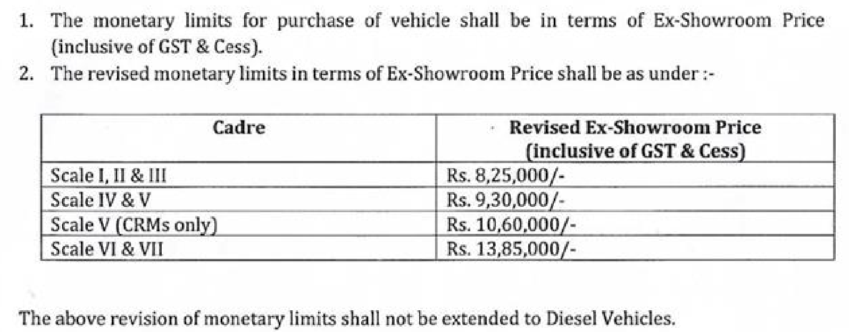
Conveyance Scheme (2011) for eligible Class I Officers-Mktg
The office will book the vehicle under this scheme
The vehicle will be purchased, owned and registered in the name of the company
The User Officer will enter into an agreement as per prescribed standard draft for the use of the vehicle
Maximum of 25% of the above cost limit is allowed on the Ex- Factory price,

Slide 54
Running expenses (Fuel limit) would be as under:Conv.Scheme 2011 Quarterly Basis:
Category | Quarterly Limit
CMD | No limit
Scale VII | 375 Lts.
Scale VI/CRM | 300 Lts.
Scale V other than CRM | 250 Lts.
Officers-in-charge of DOs/BOs, Scale IV In-charge of RNTB & Marketing Department at RO, Officers-in-charge of DTC (Cleaning: Rs. 650 p. month) | Metro | 250 Lts.
 | A Class City | 225 Lts.
 | B Class City | 180 Lts.
 | C Class City | 150 Lts.
The period of usage of car under this scheme will be 5 years. Extended: to 8 years
Number of times the Conveyance facility is provided is 4 times upto Scale IV and 3 times in Scale V and above excluding DO loan scheme.
After that the car shall be transferred in the name of the Officer concerned by recovering an amount equal to the written down (Depreciated) value of the car determined as per rules in force from time to time
Cost of Tyres and tubes shall be borne by the company in full after 32,000 Kms./40 months which ever is earlier. Reimbursement will be made subject to production of bills/receipts.
If retreading of tyres is required, the cost of such retreading shall be borne by the company after the car has run 16,000 Kms. Salvage: Rs. 350
Repairs: a) Service charges: Rs. 1000 p.a b) Major: 50000/55000/60000

Slide 55
The cost of batteries shall be borne by the company in full after 18 months of date of purchase of the vehicle and after every 18 months thereafter subject to production of bills/receipts. Salvage: Rs. 150.
Cleaning Charges – Rs.650/- p.m.
Pollution Check – Actual . (No penalty in this respect is payable)
Exit: 1) Within 1 year to admin: Full purchase price
2) Within 1 year due to retirement/death: SLM @ 20% depn on actual period. Diff: RBM-SLM= perquisites
4) After 5 years exit: WDV after 5 years/8 years on RBM—perquisites.
5) After 1 year to admin: WDV on RBM to pay (dt to dt). RBM-SLM=perqs.
6) Foreign posting: Either surrender or keep the car by pmt.
N.B. In case any officer (Scale III, IV ) who has availed vehicle loan and purchased a four wheeler, is shifted to marketing side or promoted to Scale V, and thereby becomes entitled to a vehicle under Conveyance Scheme of the company, can adopt one of the following two courses :
Convert the existing vehicle in the name of the company and come under the company’s Conveyance Scheme
Repay the balance of loan amount obtained from the company for purchase of the vehicle. Then go for a vehicle under Conveyance Scheme 2002, under which he becomes entitled.

Slide 56
RETIREMENT BENEFITS

Slide 57
GRATUITY
Retirement | Death | Vol. Retirement | Resignation
Gratuity as per Act/Scheme Under Act: (Basic+DA+FPA ) x 15/26 x No. of yrs. of continuous qualifying service, subject to maximum of Rs.20 lacs (enhanced w.e.f. 28.03.2018) | Same as Retirement. (Death certificate along with Gratuity Nomination Form, is reqd. to be sent. In absence of Gratuity nomination form, succession certificate would be necessary for settlement of Gratuity.) | Same as Retirement | Calculation is Same as Retirement. However, Gratuity is payable after minimum of 5 years of service. No gratuity payable on termination.
As per scheme: For Class I For 15 years and above: Last drawn basic pay + FPA) X 15 + (50% of last drawn basic pay X no. of yrs. Of service beyond 30 years) | As per scheme: 1 to 11 yr. 50% of last drawn basic pay X no. of yrs. Of service. 12 yrs. 60% of last drawn basic pay, 13 yrs. 70% of last drawn basic pay and 14 yrs. 80% of basic pay. For service of 15 yrs. and above, same as retirement | Same as retirement | Same as retirement. However, gratuity is payable only on completion of minimum of 5 yrs. service
As per scheme: For Class III & IV Last drawn basic pay + FPA) X 15 up to 15 years of service. For 15 years and above: Additional 1 month basic pay for each year of service beyond 15 yrs. (subject to max. of total 20 months) | As per Gratuity Act, 1972, year in which employee does not complete 240 working days, shall not be taken into consideration for the purpose of payment of gratuity, In other words, if an employee is on loss of pay for more than 125 days in a year (to be calculated backward from the month of retirement) will not be considered.

Slide 58
PENSION
Retirement | Death | Vol. Retirement | Resignation
Pension Formula 50% of last 10 month’s average basic pay + FPA X No. of yrs. of service /33 (full pension is admissible on completion of 33 yrs. of service) | Instead of last 10 months’ average Basic Pay, only last month’s basic pay is taken for computation GTIS death claims last six month’s pay | Same as Retirement {Notional benefit of service up to 5 years (Max) can be given to those who had total 33 or more years of full service} | Not eligible for Pension, if resigned before 20 yrs of continuous service.
Commutation: Max. 1/3rd of his/her calculated basic pension. CMD can commute upto 40%.
Single/Double Family Pension: In case of demise of retiree before 66th birthday—double pension for maximum 7 years or till retiree reached 66th birthday had he been alive (earlier). Maximum period for which family pensioner entitled double pension is 84 months.
ELIGIBILITY: MINIMUM 10 YEARS OF SERVICE. EXTRA-ORDINARY LEAVE, LOP < 12 MONTHS SHALL COUNT AS QUALIFYING SERVICE. IF BROKEN PERIOD OF SERVICE <6 MONTHS, IT SHALL BE IGNORED.
Merger: 4708 wef 01/08/12 as amended In respect of employees retired and/or died on or after 01/08/16.
Rate of Family Pension
Scale of Pay
upto Rs 10820/- -30% of pay .... plus 30% of allowance, min Rs 3010/- pm
upto RS 10821/- to Rs 23540/- -20% of pay ... plus 20 % of allowance, min of Rs 3570/- pm
Rs 23541/- & above – 15% of pay.. plus 15% of allowance min of Rs 4720/-
NOTES: - (1) Dearness Relich is not payable on additional family Pension (2) If the surviving child or children are eligible to draw 2 family pension, both pensions shall be limited to Rs 37,290/- (twice 15% of maximum scale in respect of employees who have retired or died while in service, on or after 01/08/2012.
MINIMUM PENSION WEF 01/08/2012 Rs 3010/- pm

Slide 59
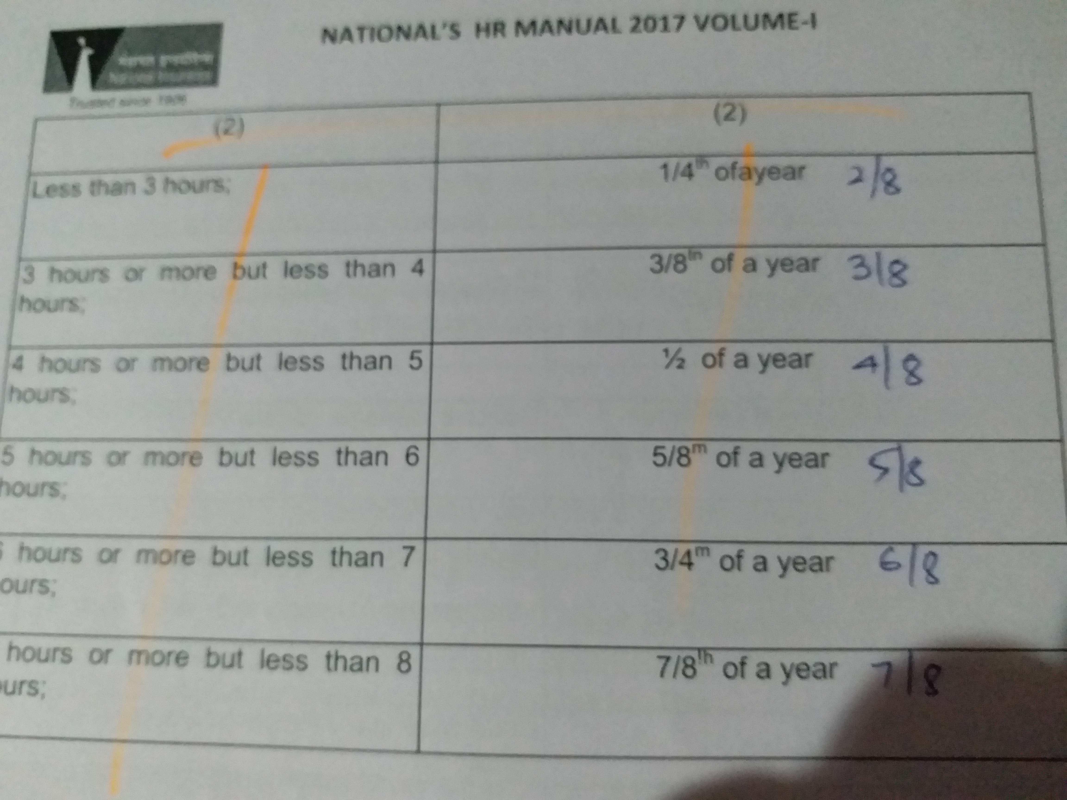
CALCULATION OF PENSION FOR
Permanent Part time Employees
Actual service rendered on Permanent Part time basis ! Length of Qualifying service for each year

Slide 60
GROUP TERM INSURANCE SCHEME REVISED W.E.F 01.12.2021
In the event of death of such an employee, a fixed amount, according to the basic pay of the employee at the time of death, is paid by LIC to the legal heirs, for which a monthly premium is deducted from the employee’s salary and deposited with LIC.
The following chart would show the basic pay–wise rate of monthly premium as well as the amount of sum assured for individual employees:

Slide 61
Group Savings Linked Insurance Policy (GSLIP)
w.e.f 20/11/2013
In case of untimely death of employee, family members are protected by this Scheme up to sum insured PLUS savings portion (75% of deposited amount) with interest.
75% of the deposit along with interest is payable after Retirement / Vol. Retirement & Resignation.
Basic Pay-wise category vis-à-vis sum insured and monthly rate of deduction of premium are shown in the following chart
Category | I (Basic Pay Rs.94466 & above | II (Basic Pay Rs.68106 to 94465/-) | III (Basic Pay Rs. 48530 to 68105/- | IV (Basic Pay Rs.25991 to 48531/- | V (Basic Pay Rs.13961 to 25875/-) | VI (Basic Pay Below Rs.13960)
SUM INSURED | Rs.10.5 lacs | 8.40 lacs | 6.30 lacs | 4.2 lacs | 3 lacs | 1.70 lac
Monthly deductions
Savings | Rs. 595 | 476 | 357 | 238 | 170 | 97
Premium | Rs. 315 | 252 | 189 | 126 | 90 | 51
Total. | Rs. 910 | 728 | 546 | 364 | 260 | 148

Slide 62
ENCASHMENT OF EARNED LEAVE ON EXIT
Maximum 240 days. Taxable.
Retirement | Death | Vol. Retirement | Resignation
Basic+DA+ FPA | Same + HRA+ CCA (excluding Transport & Washing allowance) | Same as Retirement | Not eligible for Encashment

Slide 63
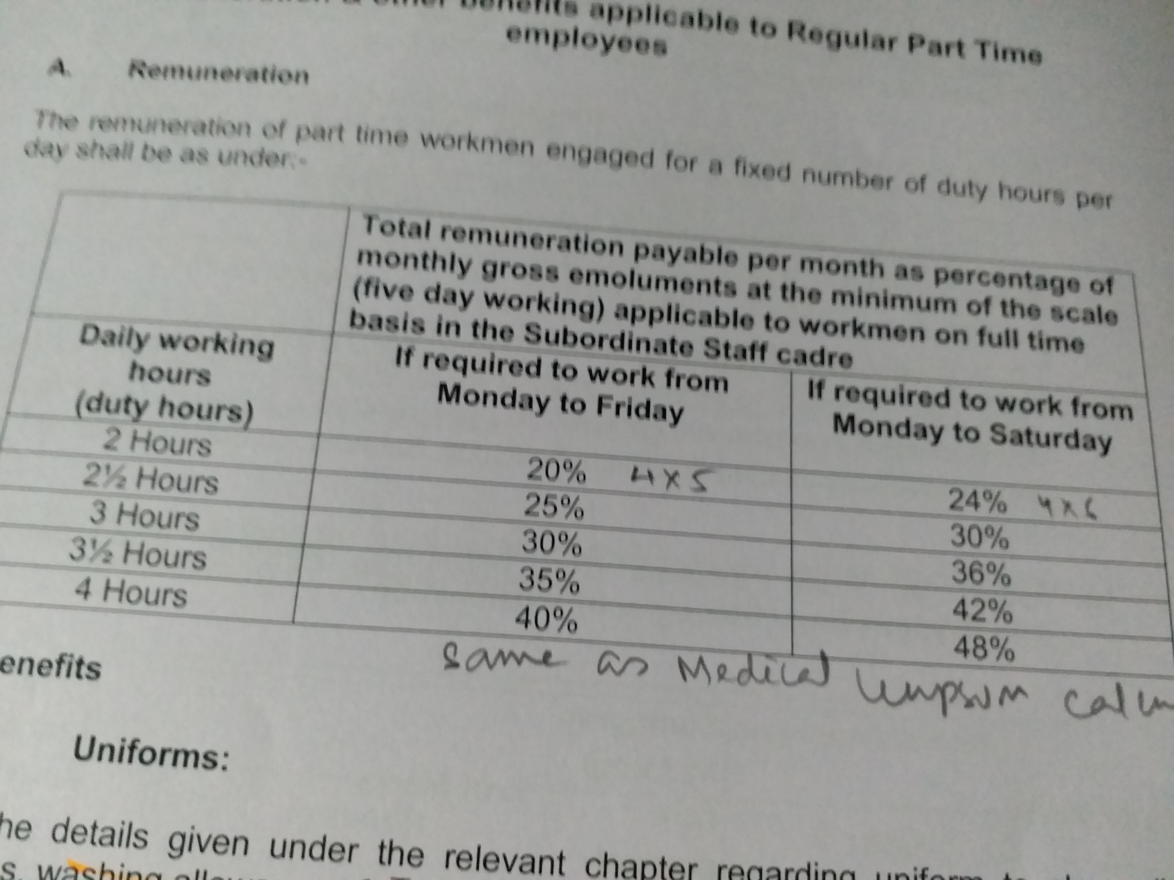
EX-GRATIA MEDICAL REIMBURSEMENT IN CASE OF HIGH COST/PROTRACTED TREATMENT:
28 specified diseases.
For all confirmed employees, non-earning spouse, 2 children.
Limits for Ex-Gratia reimbursement both for treatment in India and treatment abroad:
Frequency: Twice during the entire service of the employee.
Overall limit each occasion being Rs.5, 00,000/-, unutilised portion of limit for one occasion can not be used for another occasion.
Limits: 90% of the amount claimed (of uncovered balance), subject to maximum of Rs.
3, 00,000/- and this provision will uniformly apply for employees as well as their eligible dependents.
Further, if the uncovered expenses are beyond ex-gratia eligibility of 3,00,000/- (i.e. beyond 3,33,333/-), the same shall be considered for reimbursement to the extent of 80% of amount in excess of 3,33,333/- subject to overall limit of Ex-gratia Medical Relief of 5,00,000/-.

Slide 64
Welfare Schemes available under Dr. Babasaheb Ambedkar Welfare Trust of GIC & GIPSA Companies
1. Reimbursement of school fees, books, notebooks and school uniforms (maximum 2 children) for children of Part/Full Time Sweepers belonging to SC/ST/OBC employees | Maximum limit Rs.500/- per child
2. Reimbursement of expenses towards cost of books, fees incurred for MBBS, MBA, Engineering, and L.L.B. for the children of SC/ST/OBC employees from Recognized Universities by UGC after completion of Degree course. | Maximum limit Rs.5,000/- per child on production of Degree Certificate
3. For passing Insurance examinations for SC/ST/OBC employees | Licentiate : Rs.500/- Associate : Rs.1,000/- Fellow : Rs.2,000/-
4. Dr. Babasaheb Ambedkar Scholarship for Higher Education: For Medical, Engineering, P.H.D.(Doctorate) for the sons/daughters of Class IV SC/ST/OBC employees from RecognizedUniversities by UGC after completion of Degree course. | Rs.25,000/- on production of Degree Certificate.
5. Dr. Babasaheb Ambedkar State Merit Scholarship : Son/Daughter of SC/ST employees who stood first in the respective State/Union Territory of class 10th and 12th. | A laptop or Rs.25,000/- whichever is less on production of necessary certificate.
6 Dr. Babasaheb Ambedkar Special Grant. For wedding of one daughter of class IV SC/ST employee. | Rs.11,000/- on production of necessary proofs.

Slide 65
ESTABLISHMENT
Room rent of Transit flat/Guest house:
Company officials including retired : Single occupancy—12/day.
Double occupancy—Rs. 16/day
Govt. officials and other PSU: Single occupancy—50/day.
Double occupancy—Rs. 100/day
Other: Single occupancy—Rs. 150/day.
Double occupancy—Rs. 300/day.
Occupation in Transit Flat/Guest house: No stay beyond 180 days.
Bachelor Accommodation: 1) No family allowed. 2) Rs. 450 p.m.
No HRA recovery. No caretaker.
Carpet area of DO: 2000 sq. feet + 10%
BO: 1000 sq. feet + 10% addnl.

Slide 66
PROMOTION POLICY FOR OFFICERS- 2006
1990 Policy was replaced the 2006 Policy
The Policy is applicable to all promotions up to & including Scale VII(GM)
Promotions from Scale V to VI and from Scale VI to VII are held within 4 GIPSA member Cos. And GIC taken together, based on a common seniority list for Scale V & VI officers for all the five companies
Other promotions within the company up to Scale V are based on all India Seniority lists of officers in Scale I, II, III & IV cadres.
Eligibility Criteria for promotion to Scale VI & VII - minimum 2 years service
Eligibility Criteria for promotion to Scale II to V – minimum 3 years service
Zone of Consideration:
(a) Scale-IV to V: 5 times the number of vacancies,
(b) Scale-III to IV: 4 times the number of vacancies,
(c) Scale-II to III and Scale-I to II: 3 times the no. of vacancies.

Slide 67
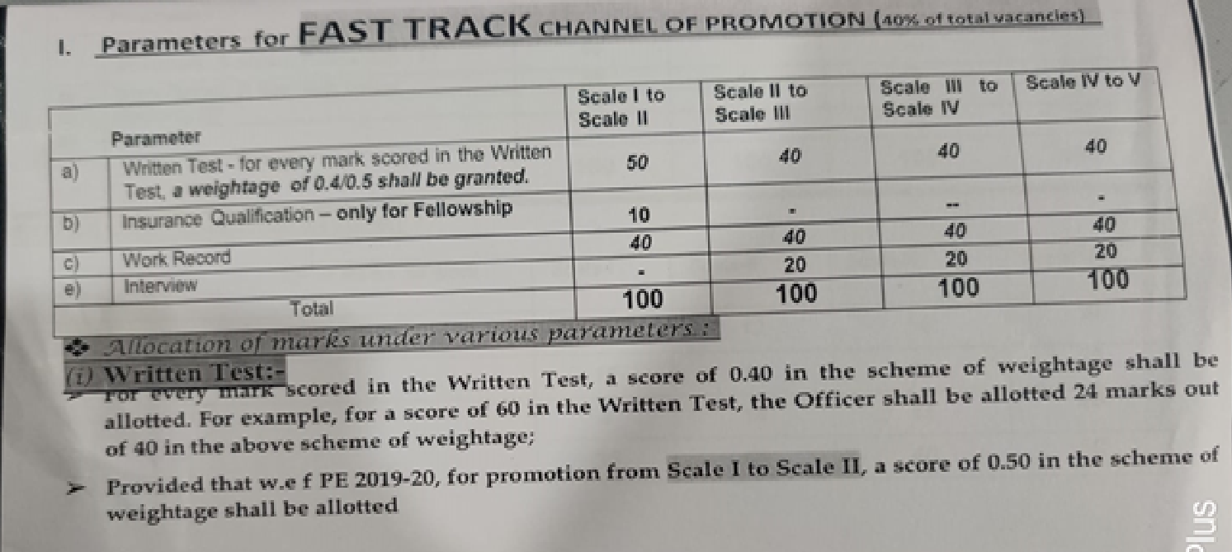
Criteria for promotion up to Scale V and scheme of weightage to various parameters
Quota for promotion under FT is increased to 40%. However, in case the total no. of candidates successful in the written examination for that cadre under fast track is less than 1.5 times the no. of such vacancies, the no . of vacancies will be suitably Reduced. After reducing the vacancies, in this way and unfilled vacancies under fast track, if any, would be shifted to normal channel. NO Interview for FT from scale-I to scale-II.

Slide 68
In assessment, maximum Weightage in terms of numerical marks for various criteria shall be worked out as under: -
Parameter | Scale I to II |  | Scale II to III |  | Scale-III to IV | Scale-IV to V
Insurance Qualification | 10 |  | 10 |  | -- | --
Work Record | 35 |  | 40 |  | 40 | 50
Seniority | 55 |  | 50 |  | 35 | 25
Interview | -- |  | -- |  | 25 | 25
Total : | 100 |  | 100 |  | 100 | 100
Eligibility Criteria: Complete 3 years service in the present cadre as on 31st March immediately preceding the relevant promotion year.
Qualification: The criteria of Technical qualification for eligibility for promotion to Scale III under fast track channel enhanced to Fellowship from Associate and so, no qualification marks are applicable for Scale II to Scale III promotion under Fast track.
(iii) Work Record:- The work record shall be assessed through the annual confidential reports as per the annual performance appraisal system in force, after applying an appropriate factor so as to translate the score from the Normal Channel level of weightage to the Fast Track level of weightage.
(For example, for promotion to Scale II, the weightage for Work Record under Normal Channel is 35 and under Fast Track Channel 40. In such a case, the score of Work Record assessed under Normal Channel as per the annual performance appraisal system in force shall be multiplied by a factor of 40/35 to arrive at the score of Work Record under Fast Track Channel.

Slide 69
Work Record: Marks are allotted on the three parts of Annual CR as under, for different cadres and mean of total marks allotted for last three years’ CRs are taken as marks on work record.
Part of CR | Scale I to II | Scale II to III | Scale III to IV | Scale IV to V
Trait | 12 | 12 | 10 | 10
Performance | 15 | 14 | 15 | 20
Growth Potential | 8 | 14 | 15 | 20
Total | 35 | 40 | 40 | 50
Seniority: For the first three completed years of service, no marks are allotted. For each completed year of service in the existing cadre, beyond first three years, the marks on seniority are allotted as per following table:
Scale | Marks for each completed year of service as on 31/3 | Maximum Marks
I | 7 | 55
II | 6 | 50
III | 4 | 35
IV | 3 | 25

Slide 70
Miscellaneous:
Maximum no. of attempts for writing examination under fast track is 2, which shall be counted within the overall 3 attempts allowed including those under normal channel.
Any officer selected both under Fast Track and normal channel, would be promoted under normal channel.
Sealed cover: For cases under vigilance scrutiny or candidate not receiving vigilance clearance, to be kept for 1 year under sealed cover for any exoneration during this period.
Special Provision for SC/ST
Instructions received from time to time from D.O.P.T., Govt. of India regarding this matter, are implemented .
No provision for reservation as yet, for Promotion within Cl. I

Slide 71
Inter-se seniority : 0.01 mark is added in the ascending order starting with 0.00 for the last officer in the list of a particular batch, if there is more than one batch in the zone of consideration. This is to ensure weightage on inter se seniority within the batch
Interview : For promotion to Scale V, the Promotion Committee compulsorily interviews all the candidates. Maximum marks for interview is 15.
Promotion Committee : Promotion committees for various promotions would be as under :
Promotion to Scale | Committee Members
VI & VII | CMDs of GIPSA Companies and GIC, besides one Govt. of India Nominee
V | CMD of the company, one Director on the Board of the Company, Genl. Manager (Pers.), one SC/ST Representative & one outside expert.
II, III & IV | CMD of the Co., two GMs of the co. {including GM(Pers.)} and one SC/ST Representative
Promoting Authority for Promotion:
Cadre | Appointing Authority
Scale VI & VII | CMD
Scale IV & V | GM
Scale II & III | DGM

Slide 72
Effect of CDA/Vigilance cases on promotion
In case any action under CDA Rules is pending against any employee at the time of considering his/her promotion, the matter would be dealt with in terms Sealed Cover Guidelines, which are issued by DOPT from time to time.
Where, however, any case is concluded and any penalty has been imposed, the promoting authority would examine various aspects of the case, such as gravity of the offence, penalty imposed, period elapsed etc. and would take a decision, as to whether the employee should be considered for promotion.
Effect of Supersession : Officers superseded in three consecutive promotional exercises, shall not be included in the zone of consideration in two immediately succeeding promotional exercises.
Effect of Non-acceptance : When an officer declines to accept promotion, such refusal shall be recorded and taken into account while considering his/her case for subsequent 1 year.
Probation on Promotion : Officers promoted to the cadre of Scale V and above shall be on probation for a period of one year.
Seniority in promoted cadre : Seniority in the promoted cadre is reckoned from the date of selection maintaining the inter-se seniority in the pre-promoted cadre, regardless of the date of taking charge, provided, however, the officer joins the higher post before 31st March of the promotion year.
Promotion, however, takes effect from the actual date of taking charge in the higher cadre at the stipulated place of posting.

Slide 73
PROMOTION POLICY FOR SUPERVISORY, CLERICAL AND SUBORDINATE STAFF, 2008
According to the above new Promotion policy for Supervisory, Clerical and subordinate Staff, there has been promotion only to following 3 cadres:
AO (Scale I) Sr. Assistant & Assistant.
While AO and Assistant, are considered as entry-cum-promotional cadre, Sr. Assistant is exclusively a promotional cadre.
For promotion to above cadres, the country has been divided into various geographical zones, as shown below:
P R O M O T I O N Z O N E S F O R P R O M O T I O N T O A O
Promotion Zone | States & UTs in cluded
Northern Zone | J&K, HP, UP, Punjab, Haryana, Uttarakhand, Rajasthan, Chandigarh and Delhi
Eastern Zone | Bihar, Jharkhand, WB. Sikkim, Orissa, Assam, Tripura, Manipur, Mizoram, Nagaland, Meghalaya & Arunachal Pradesh
Southern Zone | Andhra Pradesh, Tamilnadu, Karnataka, Kerala and Puducherry
Western Zone | Maharastra, Gujarat, Goa, Madhya Pradesh, Chattisgarh, Dadra & Nagar Haveli and Daman & Diu

Slide 74
Name of Prom Zone for Sr. Asstt. | State(s)/UT covered
Northern Zone I | Punjab
Northern Zone II | J & K, HP and Chandigarh
Northern Zone III | Haryana and Delhi
Northern Zone IV | UP & Uttarakhand
Northern Zone V | Rajasthan
Eastern Zone I | Bihar & Jharkhand
Eastern Zone II | W.B & Sikkim
Eastern Zone III | Orissa
Eastern Zone IV | Assam, Tripura, Nagaland, Mizoram, Manipur, Meghalaya, Arunachal Pradesh
Southern Zone I | Andhra Pradesh
Southern Zone II | Tamilnadu & Puducherry
Southern Zone III | Karnataka
Southern Zone IV | Kerala
Western Zone I & II | To be carved out by CMD comprising offices in Maharashtra and Goa
Western Zone III | MP & Chattisgarh
Western Zone IV | Gujarat, Dadra & Nagar Haveli , Daman & Diu

Slide 75
For promotion to Assistant :
Prom. Zone will be RO Area
If any RO covers more than one state, Promotion zone will be State; and
If there is more than one RO situated in one centre, all such ROs would be clubbed to form a Promotion Zone.
Promoting Authorities and Promotion Committees
For promotion to | Promoting Authority | Promotion Committee
AO (Scale I) | An Officer not below the rank of Scale VI (DGM), to be nominated by CMD | An officer not below the rank of Scale V to act as Chairman and two other officers not below the rank of Scale IV
Sr. Assistant | An officer not below the rank of Scale V to be nominated by the O-I-C of the HO Pers. Dept. | An officer not below the rank of scale IV to act as Chairman and two other officers not below the rank of Scale III, as members.
Assistant | An officer not below the rank of Scale IV to be nominated by the Regional In-charge | An officer not below the rank of scale III to act as Chairman and two other officers not below the rank of Scale II, as members.
N o t e:
One member of the Promotion Committee each shall be from Personnel Department & SC/ST . Promotion Committee shall also act as Interview Committee, wherever interview is prescribed.

Slide 76
Promotion to AO (Scale I):
Departmental Channel:
Only Sr. Assistants & Stenos are eligible to apply. Eligibility criteria are based on period of service rendered in the present cadre & the Insurance &/or professional qualifications acquired.
Selection is based on seniority, qualification (academic and insurance/professional), work record and interview.
Competitive Channel:
Any employee who is graduate marks in any degree examination or FIII (AIII for SC/ST) ACA, ACWA, MCA, MBA etc. are eligible to write the competitive examination not more than four occasions (5 for SC/ST) in the entire service career. Qualifying marks in the competitive examination is 60 % (50% for SC/ST) for being considered in the further process of selection.
Selection under this channel is based on seniority, qualification (academic and insurance/ professional), work record, interview and the marks in the competitive examination.
Promotion to Senior Assistant:
All employees in the scale of Assistant who are FIII/MBA/MCA or who have completed at least 7 years in the cadre or who have reached the ceiling of the scale are eligible for this promotion.
Employees with LIII or AIII qualifications, are considered only after putting in at least 5 years and 3 years service in the cadre, respectively.
Selection is based on seniority, qualifications (academic and insurance) and work record

Slide 77
Promotion to Assistant:
Before Amendment :Record Clerks and Class IV full time employees are eligible for this promotion, provided they have requisite academic qualifications for direct recruitment of Assistant in the company or they pass the departmental test with 50% marks (40% for SC/ST) and also pass the computer literacy test
Record clerks with at least 5 years service and Subordinate Staff with 10 years service and who have qualified at least VIII std. examination are eligible to write the departmental examination
AFTER AMENDMENT :-
Confirmed Sub-staff/Drivers/RCs who posses minimum educational qualification laid down for direct recruit of Asstt. Provided they have passed Eng/Hindi as one of the subject at SSC/Graduation level.
OR
passed the departmental test for promotion to the cadre of Asstt. with 45% marks (36%) for
SC/ST candidates during any of the PE conducted upto PE 2015-16
OR
put in at least 10 yrs. Of service as full time employee & has passed Matriculate Exam (Xth
standard) from a recognized institute.
AND
B. Passed the Computer-literacy –and –proficiency-test as prescribed by the Management for the relevant PE or any of the two (2) PEs immediately prior to the relevant Promotion Exercise.

Slide 78
Scheme of weightage for various criteria:
Criteria | For Prom to AO(Scale I) | For prom to Sr. Assistant | For Prom to Assistant
Seniority | 35 | 50 | 50
Qualifications | 30 | 30 | 30
Work Record | 20 | 20 | 20
Interview | 15 | - | -
T o t a l | 100 | 100 | 100
Marks on seniority:
Two marks for each completed year of service (in the cadre, for prom. to AO under para 13.1 and Sr. Asstt. & in the company for promotion to AO under para 13.2. and Assistant) as on 31st December of the year preceding the year of promotion are allotted.
Period of 6 months and more is considered as one year and less than 6 months period is ignored.
Marks on Qualifications:
Academic Qualifications:
Below SSCE | 0
SSCE | 5
HSC/Intermediate | 7
Graduate | 12
Post/double Graduate | 15

Slide 79
Technical Qualifications:
LIII or one subject of Institute of Actuaries or PG Diploma (one yr. duration) in Computer Applications/MBA/PG Diploma (2 years) in Business Admn./Management (PGDBM) | 5
AIII or ACII or three subjects of Ins. of Actuaries | 10
FIII or FCII or 5 subjects of Ins. of Actuaries or MCA or ACS qualification | 15
Marks on work record:
Past three years CRs are to be rated by the Promotion Committee as per the scheme of rating and 3 years average shall be taken as marks on work record.
Marks in Interview:
Promotion Committee shall give marks to the candidates for promotion to AO on the basis of their performance in the personal interview before the committee. None shall be included in the Ranking list without appearing in the Interview.
NEW PROVISIONS AFTER LATEST AMENDMENT IN PROMOTION POLICY FOR SCS, 2008
INTRODUCTION OF CONTINGENCY LIST :-
1. A. Promotion Committee shall select candidates equal to 10% of the respective no. of vacancies in each cadre and in each category (fraction below 0.5 will be ignored and above 0.5 will be taken as 1), and place them in order of their ranking to constitute the Contingency List for promotion, to be published in the ranking order. The candidates in C.L will be offered promotion in order of their ranking only against refusal of offer of promotion by any candidate selected in respective Promotion List.
B. The unutilized portion of C/L would lapse on 31st March, without carrying any preferential treatment in any subsequent promotion exercise.

Slide 80
2. FILLING UP UNFILLED VACANCIES UNDER PARA 13.2 IN A PROMOTION-ZONE Unfilled vacancies for promotion to the cadre of Scale-I under Para 13.2 under any category (UR/SC/ST) in zone, after offering promotion from Contingency List, shall be filled up by selecting candidates from other zones who are eligible to be considered for the promotion and give consent for Out of Zone posting on promotion. A. Option to be obtained at the time of applying for promotion under para 13.2 B. Common Ranking List (All Zones) shall be prepared in the each category, in the descending order of marks obtained, of the candidates who opted for out of zone promotion and have not been offered promotion in their respective zones. 3.Effect of Non-acceptance of Promotion :- On refusal/ non-acceptance of promotion, the employee shall forfeit his/her right to be considered for promotion to that cadre in next one (01) Promotion Exercise
15% and 7-1/2% vacancies are reserved for SCs and STs for various promotions under this policy. Rosters for reservation of vacancies are maintained promotion zone-wise for each promotion.
3% reservation is also made for persons with disability.
In addition, under paragraph 13.2 and 15, certain relaxations are provided to the SC/ST employees in eligibility criteria, No. of chances to appear in the Competitive Examination (Under paragraph 13.2 )and qualifying marks in the written tests.
Special provision for SC/ST & persons with disability: -

Slide 81
Assured career progression scheme (ACPS)
Record Clerks, Drivers & Sub-staff who have reached the ceiling of the respective pay scale as applicable to them from time to time shall, on completion of continuous 12 months service from the date of their reaching the maximum (ceiling) of their present scale or from the first of month following coming of this policy in force, whichever is later, be placed in the pay scale of one step higher cadre, subject to vigilance clearance.
While the employee would continue in the existing cadre, he/she would only draw salary in the higher scale, till superannuation.
Except monthly salary, no other facility/benefits which may be applicable to the higher cadre, would be admissible to such employees on placement in the higher scale under ACPS.
Now this is not a one time facility for an employee in entire service career.

Slide 82
One promotion in life time for Assistants
Assistants not below the age of 50 yrs. and who have completed at least 20 yrs. Of service in the company without receiving any promotion are eligible for promotion to Sr. Assistant, under this clause.
The promotion is subject to vigilance clearance and would be based on the marks on the criteria of Seniority, qualifications and Work Record, provided the employee not found unfit for promotion. Weightage on seniority is given @ 3 marks per year, over and above the service of 20 years.
Past service of the ex-servicemen, before joining the Co. is counted up to maximum of 5 years, for determining the eligibility for promotion which is minimum of 20 years of service as Assistant
Power to clarify, modify and relax any provision of the policy
CMD is the competent authority to modify or relax any provision of the policy in any individual cases, by recording the reasons therefor and to issue any clarifications, in case of any doubt in any matter under this policy.

Slide 83
TRANSFER AND MOBILITY POLICY - CLASS I
Applicability
It came into existence since 17/10/2002.
Applicable to all officials up to the rank of Scale IV
Not applicable to officials on deputation to other Organizations & to local transfers.
Normal period of posting (NPP) at a centre is 5 yrs
On completion of NPP, transfer from the existing place for scale I & II, within TAC Zones/ Adjoining States. For others, Anywhere in India.
Transfer even before completion of NPP by the Management on Office Exigencies
SENSITIVE ASSIGNMENT
ROTATION FROM SUCH ASSIGNMENT AFTER 3 YRS.
SHIFTING TO ADMN. SIDE ON COMPLETION OF CONTINUOUS
10 YRS. AS DO/BO INCHARGES. ONCE SHIFTED, AGAIN ELIGIBLE
FOR POSTING AS INCHARGES AFTER 3 YRS. ON ADMN. SIDE

Slide 84
REQUEST TRANSFER
NO REQUEST ORDINARILY CONSIDERED BEFORE COMPLETING 3 YRS.
IN ONE CENTRE. HOWEVER, BOARD/PERSONNEL. & ADMN.COMMITTEE
OF THE BOARD MAY CONSIDER EXTREME HARDSHIP CASES BEFORE 3 YRS.
MAX. NO. OF REQUEST TRANSFERS = 3 ( TO BE COUNTED FROM 01.03.1990 )
REQUEST CONSIDERED AFTER 5 YRS. IN ONE PLACE TREATED AS
COMPANY TRANSFER.
TRANSFER BENEFITS
FOR OUTSATION TRANSFER, AS PER GUIDELINES TIME TO TIME.
FOR LOCAL TRANSFERS, NO BENEFIT
FOR REQUEST TRANSFERS under TMP BEFORE 3 YRS., NO BENEFIT
JOINING TIME FOR TRANSFER
NORMALLY 30 DAYS OR THE DATE SPECIFIED
2) FURTHER MAX. EXTENSION FOR 30 DAYS MAY BE ALLOWED ON MERIT

Slide 85
SUPERVISORY, CLERICAL AND SUBORDINATE STAFF
TRANSFER AND JOB ROTATION POLICY –
JOB ROTATION
After three years of continuous working in a particular Department, an employee is liable to undergo job rotation and he/she can be posted in another department within the same office
After five years of continuous working in one office, an employee is liable to undergo job rotation and in this situation he can be posted in another office within the same station.
TRANSFER AND MOBILITY
After 10 years of continuous stay in one station, an employee is liable for transfer to another station.
Distance shall be ordinarily restricted to a radius of 150 kms. from present place of posting. However, such distance may be increased up to 200 Kms. also, with the approval of CMD
May be transferred to earlier or choice station after stay of at least three years

Slide 86
Rs. 10 lakh, 2 children. Rate: 8%--Boy. 7.8%--Girl (simple interest). ELIGIBILITY : CONFIRMED WHOLE TIME SALARIED EMPLOYEES WITH 5 YEARS SERVICE. MAXIMUM 10 LACS FOR EACH CHILD AND FOR MAX OF TWO CHILDREN DURING ENTIRE SERVICE REPAYMENT PERIOD :- 10 YEARS FOLLOWING THE MONTH OF DISBURSEMENT OF ADVANCE. IF REMAINING PERIOD OF SERVICE IS LESS THAN 10 YEARS THEN THE OUTSTANDING ADVANCE WOULD BE RECOVERED FROM HIS/HER TERMINAL DUES. EDUCATION ADVANCE FOR COVERING EXPENSES LIKE ADMISSION FEE, TUTION FEE PAYABLE TO INSTITUTION/SCHOOL, NON REFUNDABLE CHARGES PAYABLE FOR HOSTEL FOR HIS/HER DEPENDANT CHILDREN PERSUING HIGHER STUDIES, PROFESSIONAL COURSES IN INDIA AND/OR ABROAD. 1. STUDIES IN INDIA :- A. GRADUATION/POST GRADUATION INCLUDING REGULAR, TECH. AND PROFESSIONAL DEGREE/DIPLOMA COURSES CONDUCTED BY COLLEGE/UNIVERSITY APPROVED BY UGC/AICTE/ BAR COUNCIL OF INDIA ETC. B. REGULAR DEGREE/DIPLOMA COURSES BY IIT, IIM ETC. C. TEACHER TRAINING/ NURSING COURSES APPROVED BY CENTRAL/STATE GOVT. D. REGULAR DEGREE/DIPLOMA COURSES LIKE AERONAUTICAL, PILOT TRNG, SHIPPING ETC APPROVED BY DIRECTOR GENERAL OF CIVIL AVIATION/SHIPPING. 2. STUDIES ABROAD - GRADUATION/POST GRADUATION /DIPLOMA//DEGREE INCLUDING REGULAR TECHNICAL AND PROFESSIONAL DEGREE/DIPLOMA COURSES OFFERED BY REPUTED /ACCREDITED UNIVERSITIES/INSTITUTES. THE ENTITLED AMOUNT OF ADVANCE WILL BE EQUIVALENT TO 85% OF AMOUNT AVAILABLE/ACCRUED TO THE EMPLOYEE ON THE DATE OF APPLICATION OF ADVANCE BY WAY OF GRATUITY/PF/GSLIP ETC.
EDUCATION LOAN- DATE OF COMMENCEMENT : 01.04.2016

Slide 87
SCHEME FOR APPOINTMENT ON COMPASSIONATE GROUNDS
Scheme for Appointment on Compassionate grounds came into force w.e.f. 01.11.2014.
It can be given to the dependent family member of an employee who :-
Dies in service (including suicide)
or
Retired on medical grounds due to incapacitation before reaching the age of 55 years.
Eligibility Criteria :-
Family is indigent and deserves immediate assistance for relief.
Applicant should be eligible and suitable under relevant recruitment rules.
Who are dependents :-
1. Spouse
2. Wholly dependent son (incl. legally adopted son)
3. Wholly dependent daughter (incl. legally adopted daughter)
4. Wholly dependent brother/sister in case of unmarried employee.
Posts for compassionate grounds appointment :-
Appt. on compassionate grounds can be given only in clerical and sub-staff cadre.
Competent Authority for CGA is CMD.
In case of missing employee :-
Appointment on compassionate grounds to the dependent of the missing employee can be considered after expiry of 2 years from the date the employee is missing, provided that :-
FIR to this effect has been lodged
Missing employee is not traceable
Competent Authority feels the case is a genuine one.
If the missing employee has less than 2 years to retire from the date he/she is missing then this scheme is not applicable.

Slide 88
NATIONAL INSURANCE COMPANY (CONDUCT,DISCIPLINE & APPEAL) RULES 2014
Application
These are applicable to every person appointed to any post by the Company including Part-timers on Company’s roll, those appointed in foreign country & are working there and shall also apply to any person governed by General Insurance (Employees’) Pension Scheme 1995, to the extent provided under the said scheme.
General Rules
Every employee shall at all times –
maintain absolute integrity,
maintain devotion to duty,
do nothing unbecoming of a public servant,
conform to all rules of the Company &
obey, all orders of superiors in course of official duty.

Slide 89
Rule 4-Misconducts (List is not exhaustive)
Theft, fraud, dishonesty in official matters
Bribery, Disproportionate assets
Furnishing false information about self which are germane to employment.
Acting prejudicial to the interest of the Company.
Willful insubordination, Neglect of work,
Absence without leave/overstayal of sanctioned leave beyond 4days
Habitual late attendance.
Damage to Company’s property.
Drunkenness/riotous behavior/gambling in Company’s premises.
Sleeping at work place.
Criminal offence including moral turpitude.
Absence from work place without permission.
Attempt at any act which amounts to misconduct.
Sharing of computer password to others without written sanction from the competent authority
Any illegal activity committed through the use of computer and/or internet
Sexual harassment of any kind

Slide 90
A few Prohibitions
Rule-5: The whole time of an employee shall be at the disposal of the Company unless it is otherwise distinctly provided.
Rule-6: No employee to seek, solicit or accept any outside employment even on honorary basis without Company’s permission.
Rule-7: No employee shall undertake any outside part time work or accept fees therefore without sanction of the Competent Authority.
Rule-8: Every employee during service or after resignation/retirement is obliged to maintain official secrecy.
Rule-9: No employee to give evidence in any enquiry without permission of the Company. This is not applicable to any enquiry ordered by Govt./ Parliament/ State legislature or any judicial/Departmental enquiry.
Rule-10: No employee can take part in election to any legislature or local authority.
Rule-13: Acceptance of Gifts-(2)- If Value of the gift is more than Rs 10000/- from relatives on religious functions or marriage etc will be intimated to Competent authority.
(3) If Value of the gift is more than Rs 7000/- from personal friends having no official dealings on religious functions or marriage etc will be intimated to Competent authority.
(4) In any other case, no gift of more than Rs 5000/- without sanction of Competent authority.
Provided, if more than one gift received from the same person/firm within a period of 12 months, it should be reported to Competent authority, if the gifts aggregate values exceeds Rs 5000/-.
Rule-14: Private trading.
Rule-16A: Submission of Property Returns.

Slide 91
Suspension (Rule-20)
The appropriate authority may place an employee under suspension
a) where a disciplinary proceeding is contemplated or is pending.
b) where a criminal offence against him is under investigation or trial.
c) where he is detained in custody, whether on a criminal charge or otherwise,
for a period exceeding 48 hours.
RULE-21 Subsistence Allowance during suspension
a) at the rate of 50% of gross salary (basic, DA, CCA, HRA, Hill Station Allowance,
qualification pay, special pay, personal pay etc.) during first 6 months.
b) at the rate of 75% after 6 months if delay in proceedings is not attributed
to him.
c) at the rate of 25% after 6 month if period of suspension is prolonged due
to reasons attributed to him.

Slide 92
SCHEDULE OF AUTHORITIES
Category of Emp/Officers | Appointing Authority | Disciplinary Authority | Appellate Authority | Memorial Authority
Sub-Staff/ Driver & Eqv. | An Officer in Scale-IV | An Officer in Scale-II | An Officer in Scale-V | CMD
RC/ Assistant & Eqv. Cadres | An Officer in Scale-IV | An Officer in Scale-III | An Officer in Scale-V | CMD
Sr. Asst/D O | An Officer in Scale-V | An Officer in Scale-IV | An Officer in Scale-VI | CMD
Officers in Scale I & I | An Officer in Scale-VI | An Officer in Scale-V | An Officer in Scale-VII | CMD
Scale-III | An Officer in Scale-VI | An Officer in Scale-VI | An Officer in Scale-VII | CMD
Officers in Scale-IV & V | An Officer in Scale-VII | An Officer in Scale-VII | CMD | Board Sub- Committee (HR)
Officers in Scale- VI & VII | CMD | CMD | Board Sub- Committee (HR) | Board

Slide 93
Procedure for imposing Major Penalties (Rule-25)
No order imposing any major penalty shall be made without holding formal enquiry proceedings into allegations/charges.
Steps in holding major penalty proceedings
a) framing of charge sheet by the disciplinary authority & its service on the delinquent employee.
b) on receipt of written statement from the employee, appointment of IO/PO by the disciplinary authority. On total admission of charges in the written statement, no formal enquiry through IO/PO will be necessary.
c) holding of preliminary proceedings, inspection of documents by the employee, submission of a list of defense assistant, defense witnesses, additional documents if any to be submitted by the employee.
d) holding of enquiry proceedings by way of examination/cross-examination of management/defense witnesses, recording of oral/documentary evidences.
submission of brief by PO to IO on conclusion of enquiry.
The Inquiry report must contain the following:
a) gist of charges.
b) gist of defense taken by the employee.
c) assessment of evidence.
d) findings on each charge with specific conclusions.

Slide 94
Procedure for imposing Minor Penalty (Rule-27)
The employee shall be informed in writing of the alleged misconduct and given an opportunity to submit written statement within 15 days.
The defense statement vis-à-vis alleged misconduct shall be taken
Into account by the disciplinary authority before passing any order.
Holding a domestic inquiry is not mandatory for Minor penalty Action.
Minor Penalties
a) Censure
b) withholding of one or more increment for a specified period.
c) Recovery towards pecuniary loss caused to the Company.
d) Reduction to a lower stage in the time-scale for a period not exceeding three years without cumulative effect .
Major Penalties
e) withholding of one or more increments permanently.
f) Reduction to a lower service or post or to a lower time-scale
or to a lower stage in the time-scale.
g) Compulsory retirement.
h) Removal from service which shall not be a disqualification
for future employment.
j) Dismissal which shall ordinarily be a disqualification for future
employment

Slide 95
Appeal (Rule-31 to 37)
Every delinquent employee has a right to appeal against any penalty order served
on him within a period of 3 months from the date of receipt of such order by him.
In case of an appeal against any penalty order the appellate authority considers
a) whether the procedures of enquiry have been complied with
b) whether findings of IO are justified
c) whether penalty imposed is excessive, adequate or inadequate
& may pass orders confirming, reducing or enhancing the penalty.
Enhancement of penalty can only be made after giving an opportunity to the employee.
Memorial (Rule-40)
An employee whose appeal has been rejected by an appellate authority or in whose case the penalty has been enhanced either on appeal or on review, may address a memorial to Appropriate Memorial Authority as per schedule of authorities in respect of the relevant matter within a period of 6 months from the date of receipt of the order of the appellate authority by him.
Canvassing or outside influence (Rule-41)
No employee shall bring any political or outside influence for any matter pertaining to his service.
Interpretation (Rule-42)
Any question relating to interpretation of these rules shall be referred to the Board whose decision shall be final.

Slide 96
THANK YOU

