Slide 1
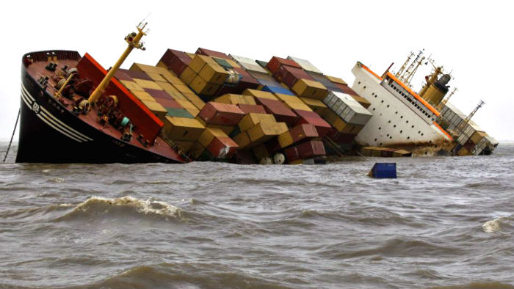
MARINE CARGO INSURANCE BY SUMON GANGULY

Slide 2
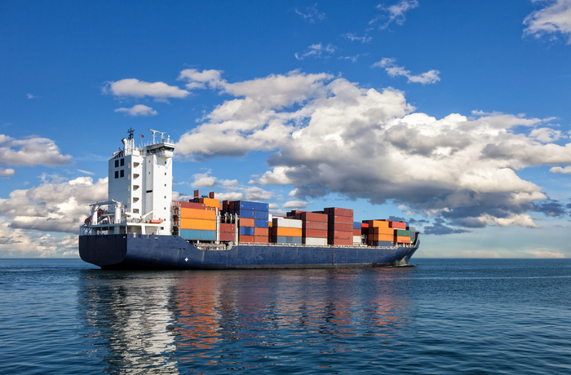
MARINE CARGO INSURANCE
INTRODUCTION
Marine cargo insurance is possibly the oldest of all the
classes of the insurance dating back to the 16th century
and earlier, when merchants gathered together to discuss
their trading and decided to share in each other’s losses.
The traders living and working around the ports of England
in 1688 used to meet in a small coffee house owned by
Edward Lloyd. Historical records show that marine
insurance was practiced in a coffee house in Lombard street, to which Edward Lloyd moved in 1691. This was the beginning of what is now the world renowned Lloyd’s of London and the London insurance market.
All trade operations of any scope, until the 17th Century, used to take place by sea, from port to port. When other means of transport developed, by river, land and later by air, Marine insurance expanded to include other modes of transportation. It is now possible to have insurance for cargoes travelling by any means of conveyance that is, ocean vessel, ferry, ocean barge, air, inland barge, truck, van and even courier.

Slide 3
MARINE CARGO INSURANCE
Role of ILU and LIRMA
The Institute of London Underwriter (ILU) was the representative body for London Market Companies outside Lloyd’s, underwriting marine insurance.
Lloyd’s of London
Similarly, the association for non-marine companies was the London Insurance and Reinsurance Market Association ( LIRMA)
In December 1988, ILU and LIRMA were merged to create The International Underwriting Association of London ( IUA). The IUA is actually involved in underwriting and claims initiatives across the industry apart from implementation of process reforms

Slide 4
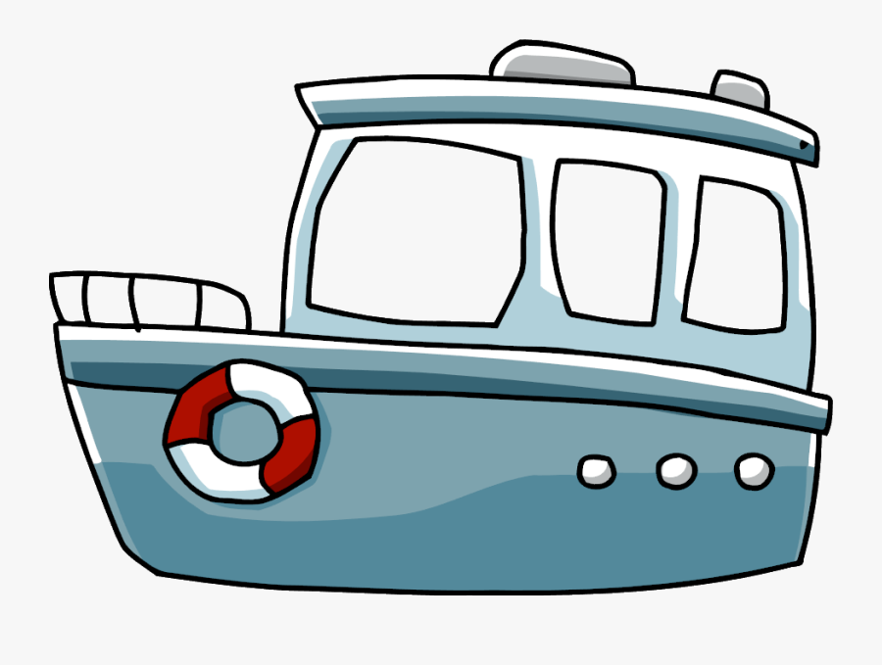
MARINE CARGO INSURANCE
Who Needs Marine Cargo Insurance?
There are many risks associated with the carriage of goods around the world. Transit insurance is not compulsory but the need for it is very real. The transport company under whose custody the loss happens cannot, in most circumstances, be held responsible for loss of or damage to cargo. This makes it difficult to obtain recovery from them. This is so because almost all types of transport companies are able to limit their liability for loss of or damage to cargo under various international conventions. This results into limitation of liability to a far lower value than the actual value of the cargo or the liability of the carrier can be even nil where for example, loss or damage is beyond their control. Therefore, who needs marine cargo insurance?
Trader needs protection against the cargo being damaged in transit
Companies that have large internal movements between subsidiaries
Despatches of raw materials and finished products by owner of the goods
Procurement of the project cargo by the principal for construction of their project
5. Banks and other lending or financial institutions may also require the borrowing company to purchase insurance in order to safeguard the investment in the trade
6. Even individuals shifting home from one city to another may need transit insurance for the household stuffs

Slide 5
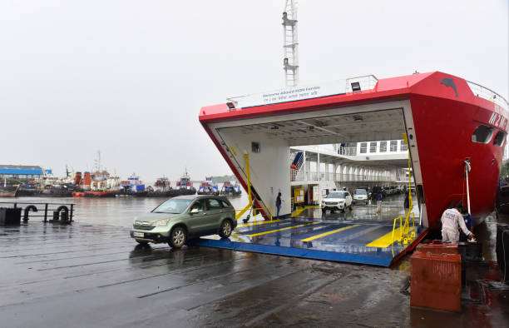
MARINE CARGO INSURANCE
WHAT IS CARGO?
Any property transported from one place to another
place is called “Cargo”
If the cargo is moved on its own power, it is not
termed as cargo. For example, The cargo clauses
generally imagine a situation where some kind of
loading aid for example a crane, is used to load the
cargo into the ship’s hold. Now a days in case of a
RO-RO vessel where automobile are transported,
the vehicle often roll in and roll out on its own power.
The simple Institute Cargo Clauses may not adequate to cover such kind of loading and unloading unless specifically mentioned the commencement and termination of cover.

Slide 6
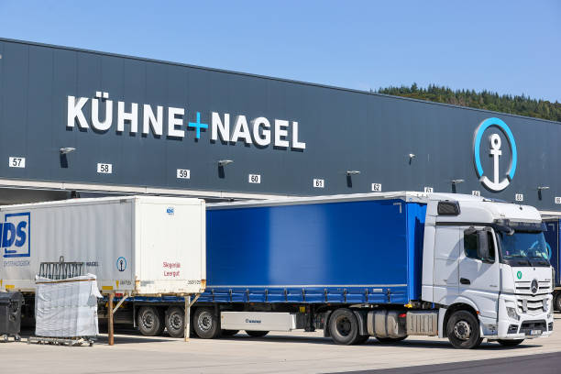
MARINE CARGO INSURANCE
WHO CAN OBTAIN MARINE POLICY?
The insurers do not grant marine insurance cover to the Carriers, freight forwarders, stevedores, clearing and forwarding agents, commission agents, either in their own name or jointly with the owner of the cargo, except where the cargo is owned by them. This is because , in this case, the proposers do not have and also do not reasonably expect to acquire insurable interest at the time of loss.
However, the Insurers may issue the policy to the Carriers as a very special case, where the goods are transported by a carrier for a particular client through out the year under a specific contract and the responsibility to insure the cargo is with the transporter. The policy, however, will be issued in the name of the owner of the goods with “ Loss payee Clause”. The owner of the goods will be indemnified, if they do not recover the loss amount from the Carriers.

Slide 7
INCOTERMS 2020

Slide 8
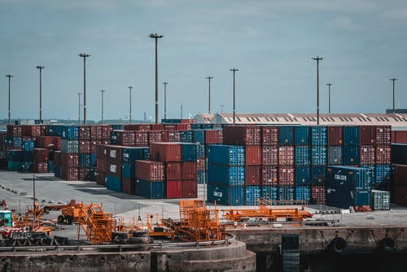
INCOTERMS
While accepting a risk the underwriters should examine
the sale or purchase contract of the client with their
suppliers or buyers. The contract negotiated between
a buyer and seller will be subject to “Terms of Sale”,
which will determine the rights and obligation of both
the parties.
There are instances where the Insurers issue policy under “Warehouse to Warehouse” terms without examining the terms of sale of the client. The issue of policy irrespective of terms of sale can not waive the requirement to establish insurable interest in the goods at the date of loss, nor does it create an insurable interest in the goods where the interest of the insured in the successful voyage of the cargo has already ceased irretrievably before completion of the insured voyage . The claim lodged by the seller will not be admitted for want of insurable interest.

Slide 9
FUNDAMENTAL PRINCIPLES OF MARINE INSURANCE
Utmost good faith, non disclosure and misrepresentation
A contract of insurance is based on utmost good faith. While accepting a risk the Insurers should consider the following
Whether the risk can be accepted on the information provided by the proposer?
If accepted, what will be the rates, terms and conditions of the policy
The insurers are dependent on the information provided by the proposer and non-disclosure of the fact will enable the insurers to avoid the contract.
Example: If the subject matter insurance describes project materials in customary packing and the item damaged turns out to be an over dimensional cargo moving without packing, the insurer can claim that the initial description of cargo did not disclose that ODC was also a subject matter of insurance.

Slide 10
FUNDAMENTAL PRINCIPLES OF MARINE INSURANCE
REPRESENTATIONS
Representations are the verbal or written statements made to
the insurer by the insured or their broker during the
negotiations of effecting the insurance. They are of two
kinds:
Matters of fact, and
Matters of expectation or belief
They are of no consequence unless they are material, when they must be true or else the insurer may avoid the contract. A statement of fact is deemed to be true provided that it is substantially correct. This means that the insurer cannot avoid the contract because it is literally true.
Example
Sugar was said to be packed in jute gunny bags but on opening the container it was found that the cargo of sugar was packed in polypropylene bag. The change of fact may not prejudice the claim for loss of or damage to cargo.

Slide 11
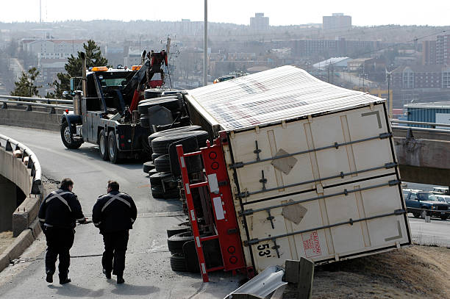
FUNDAMENTAL PRINCIPLES OF MARINE INSURANCE
INSURABLE INTEREST
Sec. 5 (1) of Marine Insurance Act, 1906 provides that every
person has an insurable interest who is interested in marine
adventure and subsection (2) states that in particular a person
is interested in a marine adventure where he stands in any
legal or equitable relation to the adventure or to any insurable
property at risk therein, in consequence of which he may
benefit by the safety or due arrival of insurable property, or may be prejudiced by its loss, or damage thereto, or by the detention thereof, or may incur liability in respect thereof.
Example: A person may insure his cargo which he owns, even if it is mortgaged . In order to recover his claim under a marine policy, he has to show his insurable interest in the goods at the time of loss.

Slide 12
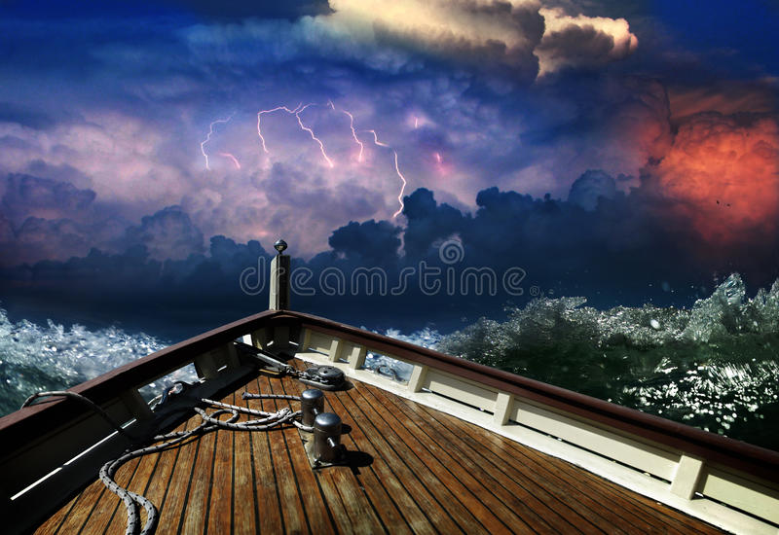
FUNDAMENTAL PRINCIPLES OF MARINE INSURANCE
INDEMNITY
The basis of contract of marine insurance is to indemnify the
pecuniary loss of the insured by the insurer. Sec.1 of the Marine
Insurance Act, 1906 provides that, “ A contract of marine insurance
is a contract whereby the insurer undertakes to indemnify the
assured, in the manner and to the extent thereby agreed, against
marine losses, that is to say, the losses incident to marine adventure”.
A contract of marine insurance is not a perfect contract of indemnity. The reason behind it is that the price of the cargo may not be the same at different places of transit. If the contract is made on the principles of strict indemnity, in some cases the insured may be over indemnified for his loss, while in other, he may stay under indemnified. This happens due to variation in price of the cargo at different places. Thus, Sec. 27(3) of MI Act, 1906 provides that in the absence of fraud, the value fixed by the policy is, as between the insurer and assured, conclusive of the insurable value of the subject intended to be insured, whether the loss be total or partial.

Slide 13
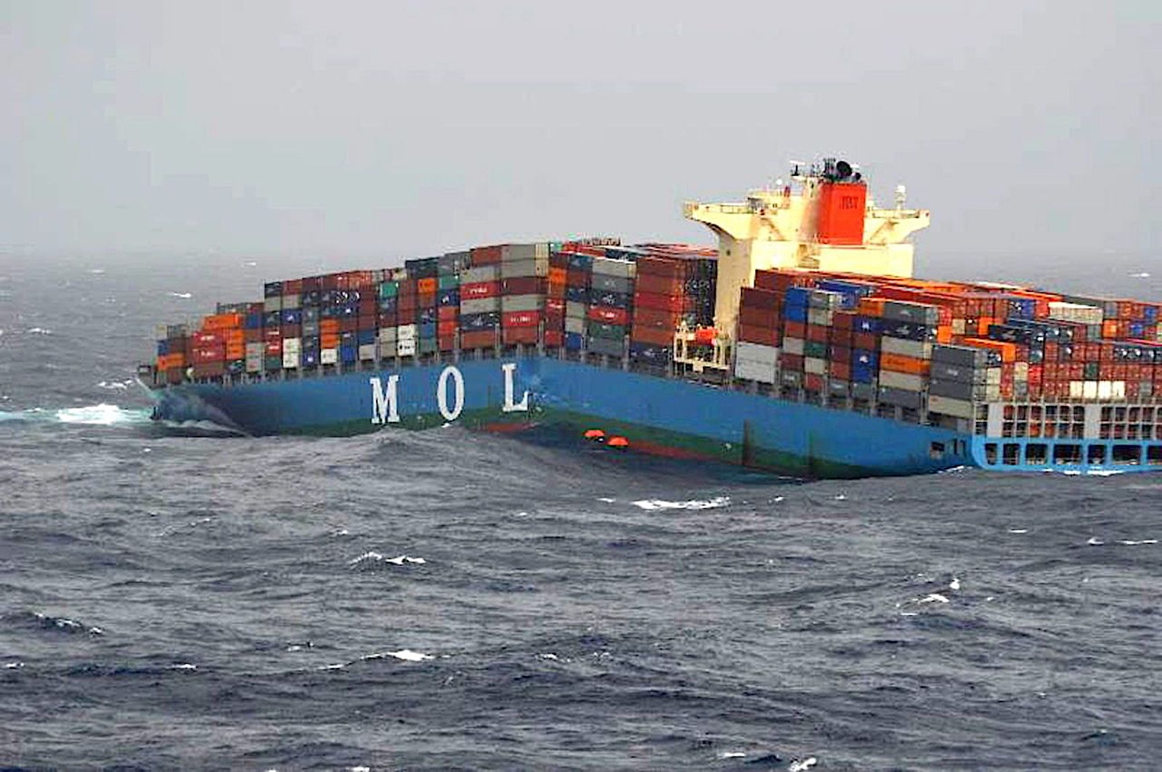
FUNDAMENTAL PRINCIPLES OF MARINE INSURANCE
PROXIMATE CAUSE
Sec.55 (1) of the Marine Insurance Act,1906 provides “ Subject to
the provisions of this Act, and unless the policy otherwise
provides, the insurer is liable for any loss proximately caused by
a peril insured against, but, subject as aforesaid, he is not liable
for any loss which is not proximately caused by a peril insured
against”
The act further states that it is the proximate cause that must be looked up to and not the remote cause. However, if the risks covered are named in the policy (for example ICC(B) or (ICC (C) ), the onus of proof will be on the claimant to show that the cause of the loss is due to an insured peril named in the policy.

Slide 14
DURATION OF COVER

Slide 15
TERMINATION OF COVER

Slide 16
TERMINATION OF COVER

Slide 17
DURATION OF COVER (INLAND TRANSIT)

Slide 18
INSURACE COVERAGE
Institute Cargo Clauses (B) and (C)
The Insurer may restrict the cover where they do not wish to offer “All risk” terms. Under a named peril policy of any sort, it has to be established by the insured as to which named peril has operated to cause loss of or damage to cargo and how it is linked to one of the named perils. The details of cover are as under:
Institute Cargo Clauses (B) | Institute Cargo Clauses ( C )
Fire or Explosion | Fire or Explosion
Vessel or craft being stranded, grounded, sunk or capsized | Vessel or craft being stranded, grounded, sunk or capsized
Overturning or derailment of the land conveyance | Overturning or derailment of the land conveyance
Collision or contact of vessel, craft or conveyance with any external object….. | Collision or contact of vessel, craft or conveyance with any external object…..
Discharge of cargo at a port of distress | Discharge of cargo at a port of distress
Earthquake, volcanic eruption or lightning | -
General Average Sacrifice | General Average Sacrifice

Slide 19
INSURANCE COVERAGE
ICC(B) and ICC (C ) Clauses cover the following named perils. The ICC( B) and ICC( C) may be extended to cover additional perils like theft, pilferage, non delivery of entire consignment, malicious damage, impact damage, flood, storm etc. subject to payment of additional premium.
Institute Cargo Clauses (B) | Institute Cargo Clauses (C)
Jettison or washing overboard | Jettison
Entry of sea, lake or river water into vessel, craft, conveyance or place of storage | -
Total loss of any package lost over board or dropped whilst loading on to, or unloading from vessel or craft | -

Slide 20
ALL RISK COVER AND EXCLUSIONS
The “ All Risk” Clause begins with “ This insurance covers all risks of loss of or damage to the subject matter insured “. There is a tendency to interpret this phrase to say that the term all risks include any of the financial losses in addition to the physical losses. This is not so. The all risk covers only physical loss of or damage to cargo subject to the following general exclusions:
1. Wilful misconduct of the assured
The cover excludes loss of or damage to cargo due to wilful misconduct (deliberate damage) of the insured, which means an action taken by the insured either deliberately or recklessly, without caring whether it is right or wrong. (4.1)
2. Ordinary leakage, ordinary loss in weight or volume or ordinary wear and tear
The cover excludes shortage of quantity due to temperature variations, evaporation, faulty calibration, density variation etc. (clause 4.2)
3. Insufficiency or unsuitability of packing or preparation of subject matter insured
Under ICC 2009, the insufficiency of packing or preparation exclusion is limited to cases where (i) the assured or their employees are themselves responsible for the poor packing or preparation, at whatever time it is carried out; or (ii) the packing or preparation is carried out prior to the attachment of the risk.

Slide 21
ALL RISK COVER AND EXCLUSIONS
4. Inherent vice or nature of the subject matter insured
The cover excludes loss of or damage to cargo due to its own nature (Clause 4.4). The damage to coal due to spontaneous combustion is an example of inherent vice.
5. Delay
The cover excludes loss, damage or expense proximately caused by delay, even though the delay be caused by a risk insured against. Losses due to delay will include loss of market or deterioration in respect of perishable goods which would not be recoverable even if the delay be caused due to the peril insured against, such as Collision ( Clause 4.5)
6. Insolvency or financial default of Carriers
This exclusion under Institute Cargo Clauses 1/1/2009 will not apply unless the insurers can prove that, at the time the subject matter is loaded on board the vessel, the assured are aware, or in the ordinary course of business should be aware, that such insolvency or financial default could prevent the normal prosecution of the voyage. Further, this exclusion will not apply under ICC 2009, where the contract of insurance has been assigned to the party claiming hereunder who has bought or agreed to buy the subject matter insured in good faith under a binding contract.

Slide 22
ALL RISK COVER AND EXCLUSIONS
7. Un-seaworthiness and unfitness exclusion
The institute cargo clauses 2009 states that in no case shall this insurance cover loss damage or expense arising from unseaworthiness of vessel or craft or unfitness of vessel or craft for the safe carriage of the subject matter insured, where the assured are privy to such unseaworthiness or unfitness , at the time the subject-matter insured is loaded therein.
The clause 5.1.2 of ICC 2009 excludes unfitness of container or conveyance for the safe carriage of the interest insured, where loading therein or thereon is carried out prior to attachment of this insurance or by the assured or their employees and they are privy to such unfitness at the time of loading
8. War, strikes, riots and civil commotions
These risks are excluded under ‘A’, ‘B’ and ‘C’ clauses but may be covered by payment of additional premium. War risk clauses do not operate during land transit. War cover operates whilst waterborne or airborne. The war cover does not commence unless the subject matter insured and as to any part as that part is loaded on the vessel.

Slide 23
CASE STUDIES
On arrival of the vehicle at an industrial estate, the employees of the insured were employed for unloading and carrying the printing machine up to the 5th floor of the building for installation. The machine fell down at the level of 2nd floor and sustained damage.
Transit details as per proposal: Mumbai to Kolkata
Cover: Inland Transit Rail or Road Clause (A) - All Risk with Loading and Unloading and SRCC
What will be the treatment of the claim?

Slide 24
CASE STUDIES
An oversized cargo was transported by multi axle vehicle from Chennai port to Bangalore. The accident to the carrying vehicle occurred on 61st day of landing the cargo at Chennai port.
The cause of delay in transit was due to severe storm. The policy was issued under ICC(A) terms.
Whether the claim is admitted due to delay beyond control of the insured?

Slide 25
CASE STUDIES
A consignment of 40 cotton bales of Rs 5,60,000 was dispatched by vehicle from kolkata to Indore. the policy was issued to cover the transit risk under Inland transit ( rail or road) Clause –B ( Basic cover). The vehicle was overturned during transit and 5 bales were damaged due to heavy weight of the vehicle. The remaining 35 bales found sound. Since it was raining, the carriers covered the sound bales by a tarpaulin.
When the surveyor went to the place of accident, he observed 5 bales in severely damaged condition due to overturning of the carrying vehicle. However, the balance 35 bales although sound even after overturning of the vehicle, were extensively damaged due to rain.
The surveyors declared all 40 bales as “Total loss”.
What will be the liability under the policy ?

Slide 26
THANK YOU

