Slide 1
Training for Promotional Exam 2022 on Motor OD
Delivered by: Vardaan Sharma

Slide 2
Motor Vehicle
“motor vehicle” or “vehicle” means any mechanically propelled vehicle adapted for use upon roads whether the power of propulsion is transmitted thereto from an external or internal source…but does not include a vehicle running upon fixed rails (GR1) or a vehicle of a special type adapted for use only in a factory or in any other enclosed premises or a vehicle having less than four wheels fitted with engine capacity of not exceeding [twenty-five cubic centimetres]

Slide 3
Battery Operated vehicle
"Battery Operated Vehicle" means a vehicle adapted for use upon roads and
powered exclusively by an electric motor whose traction energy is supplied exclusively by battery installed in the vehicle provided the following conditions are met:
(i) the thirty minutes power of the motor is less than 0.25 kW.;
(ii) the maximum speed of the vehicle is less than 25 km/h;

Slide 4
Motor Tariff Sections
MOTOR TARIFF CONTAINS 8 SECTIONS :
General Regulations
Tariff for Private Car
Tariff for Motorised Two Wheelers
Tariff for Commercial Vehicles.
Proposal forms.
Standard wordings in respect of Policy, Certificate of insurance, cover note.
India Motor Tariff (IMT) Endorsements.
Statistical codes.

Slide 5
Insured perils in Package Policy from Section 6
a) Fire, Explosion, self ignition or lightning
b) Burglary, house breaking or theft
c) Riot & strike
d) Earthquake (Fire & shock)
e) Flood, Typhoon, Hurricane, Storm, Tempest, Inundation, Cyclone, hailstorm
f) Accidental external means
g) Malicious Act
h) Terrorist activity
i) Transit by road, rail, inland water way, lift, elevator or air.
j) Land slide & rock slide

Slide 6
Exclusions
a) Consequential loss, Depreciation, Wear & tear & Mechanical & electrical breakdown, failures or breakages
b) Damage to tyres/tubes unless the vehicle is damaged at the same time (50% of cost of replacement payable)
Loss of or damage to accessories by burglary housebreaking or theft unless vehicle is stolen at the same time: Two Wheelers and Commercial Vehicles
Damage caused by overloading or strain-Commercial vehicles
c) Any accidental loss/damage suffered whilst the insured or any person driving with the knowledge and consent of the insured is under the influence of liquor or drugs
d) Loss when the vehicle is used in breach of ‘Limitations as to Use’
e) Loss when the vehicle is used in contravention of ‘Drivers Clause’
f) Losses arising directly or indirectly out of war & war like perils & from nuclear weapon material.
g) Loss or damage to accessories unless the same are on the vehicle.
h) Loss when the vehicle is used Outside geographical area
Contractual Liability Claims.
j) Any loss or damage suffered whilst the Insured or any person driving (with consent of Insured) is under the influence of intoxicating liquor or drugs. (MV Act, 1988- Sec 185)

Slide 7
GR 1 & GR 3
Motor Insurance in India cannot be transacted outside the purview of India Motor Tariff
Vehicles running on rails are excluded from Motor Insurance.
GR3:
Two Types of Policy:
Liability Only-TPL and TPPD. PA for owner-driver is also covered.
Package Policy
Restriction of Scope of Cover under Sec-1 is allowed in package policy-without any reduction in Tariff rates.
(Twice) consecutive loading of 100% may be allowed if there is adverse claims experience of vehicle insured.

Slide 8
GR 2
Proposal Form is required in case of :
Fresh proposal/New Purchase
Renewal with material alteration
Change of Insurer, i.e Renewal with different insurer.
Transfer of Policy (GR 17)
Proposal Forms are specified in Section 5 of India Motor Tariff
3. For Trade Policies other than Internal Risk, Commercial Vehicles Package Policy Proposal Form is used.

Slide 9
GR 4
Geographical Area of Motor Policies may be extended to include:
Nepal
Pakistan
Maldives
Bhutan
Bangladesh
Sri Lanka
Premium for:
Package Policies: Rs. 500/-, irrespective of class of vehicles
Liability Only Policies: Rs. 100/-, irrespective of class of vehicles
Such extension excludes cover for damage to vehicle/ injury to occupants/ TP Liability during transit through air passage/sea voyage for purpose of ferrying the vehicle to the said geographical area.

Slide 10
GR 5 and GR6
Vintage Car:
Car manufactured prior to 31.12.1940
Requires due certification from Vintage and Classic Car Club of India
Agreed Value Policy to be issued (GR 7)
OD Discount=25%(GR29)
TP discount= 50% (IRDAI TP premium Circular)
Classic Cars
Vehicles which are manufactured after 31.12.1940 but before 31.12.1970 is considered as Classic car
Requires due certification from Vintage and Classic Car Club of India
No special provision for rating or cover for such vehicles

Slide 11
GR 8
Sum Insured for Motor Vehicles is the Insured’s Declared Value (IDV)
IDV is fixed at commencement of Policy
IDV is fixed on the basis of Manufacturer’s Selling Price(MSP) at the commencement of policy
IDV is fixed by applying depreciation as per age on the MSP
Accessories and Side Car IDV are fixed in similar manner.
In case of Total Loss/CTL, IDV is the basis for compensation
Constructive Total Loss is when the aggregate cos of retrieval and/ore repair of the vehicle subject to terms and conditions of the policy exceed 75% of IDV
Total Loss Liability= IDV-Excess
Constructive Total Loss Liability= IDV-Wreck Value-Excess

Slide 12
GR 8(cont.d)
Age of the Vehicle | Depreciation Percentage
Not Exceeding 6 Months | 5
Exceeding 6 months but not exceeding 1 year | 15
Exceeding 1 year but not exceeding 2 years | 20
Exceeding 2 years but not exceeding 3 years | 30
Exceeding 3 years but not exceeding 4 years | 40
Exceeding 4 years but not exceeding 5 years | 50
Obsolete Models: Models which the manufacturers have discontinued to manufacture
IDV of vehicles beyond 05 years and obsolete models is to be determined on the basis of understanding between insured and insurer.
Example problem:
The MSP of a vehicle on 07.08.2021 is Rs. 1,00,000/-. The Vehicle was purchased on 07.05.2018. What should be the IDV on 07.08.2021?

Slide 13
GR 9
Nature of Parts | Depreciation %
ALL RUBBER,NYLON,PLASTIC PARTS, TYRES & TUBES AIRBAGS | 50%
FIBRE GLASS COMPONENTS | 30 %
PARTS MADE OF GLASS | NIL
Depreciation for painting - 50% on material cost of total painting charge. In case of consolidated bill the material component shall be considered as 25%
RATE OF DEPRECIATION FOR ALL OTHER PARTS INCLUDING WOODEN PARTS AS PER TABLE BELOW
AGE of VEHICLE | % OF DEPRECIATION
Not Exceeding 6 months | NIL
Exceeding 6 months But not Exceeding 1 year | 5
Exceeding 1 year But not exceeding 2 years | 10
Exceeding 2 years But not exceeding 3 years | 15
Exceeding 3 years But not exceeding 4 years | 25
Exceeding 4 years But not exceeding 5 years | 35
Exceeding 5 year But not exceeding 10 years | 40
Exceeding 10 years | 50

Slide 14
Example problem on GR 9
Vehicle was purchased on 08.08.2018. Vehicle met with an accident on 07.06.2021. The parts allowed by surveyor are as under:
Airbags: Rs. 10,000/-
Windshield: Rs.2,000/-
Electrical Wiring: Rs. 2,000/-.
Paint Work: Rs. 1,000/-
Vehicle’s cubic capacity is 2000cc. What is the amount of claim sanctioned?

Slide 15
GR 7
GR 7 pertains to Agreed Value Policies
Agreed Value Policies are those policies where a pre-agreed specified sum is paid on entirety as compensation in case of Total Loss/Constructive Total Loss of vehicle
No depreciation is deducted in case of TL/CTL Losses
However, Depreciation is deducted on parts in case of repair claim as mentioned in Section I of policy (GR9)
Agreed Value Policies are only to be given to Vintage Car

Slide 16
GR 10
Depending on the location of Office of registration, India is divided into zones
Private Cars/Motorized Two Wheeler/Commercial Vehicles rateable under zone 4C1 and 4C4:
Zone A: Ahmedabad, Bangalore, Chennai, Hyderabad, Kolkata, Mumbai, New Delhi and Pune
Zone B: Rest of India
Commercial vehicles excluding 4C1 and 4C4:
Zone A: Kolkata, New Delhi/Delhi, Mumbai, Chennai
Zone B: All other State Capitals
Zone C: Rest of India

Slide 17
GR 11
Earlier, no policy was permitted to be issued or renewed for any period longer than 12 months.
However, Long Term Liability Only Policies are now in existence with effect from 01.08.2018.
Extension of period of insurance less than twelve months is permitted on pro rata basis to arrive at a particular date of renewal.
However, such policies are to be renewed with the same insurer for twelve months immediately after expiry of pro-rata extension.
In case the insured fails to renew with same insurer, the difference between pro-rata and short period policy is to be charged.

Slide 18
GR 12
Short Period cover/short period renewals for Liability Only Policies are not permissible
Other than Liability Only Policies, policies can be given on short period rates
Extension of such cover can also be allowed by charging short period rates
Period | % of Annual Premium
Not exceeding 1 month | 20
Exceeding 1 month but not exceeding 2 months | 30
Exceeding 2 month but not exceedin 3 months | 40
Exceeding 3 month but not exceeding 4 months | 50
Exceeding 4 month but not exceeding 5 months | 60
Exceeding 5 month but not exceeding 6 months | 70
Exceeding 6 month but not exceeding 7 months | 80
Exceeding 7 month but not exceeding 8 months | 90
Exceeding 8 months | Full Annual Premium

Slide 19
GRs on Premium
GR13:
For Package Policies, Own Damage and the Liability components of Premium are to be displayed separately in the policy schedule.
All loadings and/or discounts on tariff rates are to be displayed separately in the policy schedule.
The premiums are rounded off to the nearest rupee
GR14: Premium to be calculated as per Premium Computation Table
GR15: Full premium to be collected before policy issuance. Payment in instalment is not allowed
GR16: Minimum premium for vehicles specially designed/modified for blind, handicapped or mentally challenged person is Rs. 25/-. For all other vehicles, minimum premium per vehicle is Rs. 100/-

Slide 20
GR 17
In the event of Transfer of Ownership of vehicle, Liability cover of Liability Only policy/ Package Policy, is automatically transferred in favour of new owner from date of transfer of registration.
For OD portion of the Package Cover, if the application for transfer is made within 14 days from date of transfer of registration, the transfer of ownership of policy will be effective from date of transfer of registration
For OD portion of the Package Cover, if the application for transfer is made after 14 days from date of transfer of registration, the transfer of ownership of policy will be effective from date of application for transfer

Slide 21
GR 17(cont.d)
Documents required for Transfer of OD section of policy:
Specific request from transferee
Consent of transferor
Fresh Proposal Form duly completed
Acceptable evidence of sale
Fresh Proposal Form is required from the transferee in respect of both Liability Only and Package Policy
For Package policies, if transferee is entitled for Nil NCB or lesser NCB, balance NCB premium is to be collected before transfer
Old Certificate of Insurance is required to be surrendered
If old Certificate of Insurance cannot be surrendered, proper declaration is to be taken from the transferee before issuance of new Certificate of Insurance
Fee of Rs. 50/-+ applicable tax is to be collected for issuance of fresh Certificate of Insurance

Slide 22
GR 18
A vehicle insured under a policy can be substituted by another vehicle of the same class for the balance period of the policy subject to adjustment of premium, if any, on pro-rata basis from the date of substitution.
Where the vehicle so substituted is not a total loss, evidence in support of continuation of insurance on the substituted vehicle is required to be submitted to the insurer before such substitution can be carried out.

Slide 23
GR 19, GR 20, GR 21
GR.19. HIRE PURCHASE AGREEMENT
GR.20. LEASE AGREEMENT
GR.21. HYPOTHECATION AGREEMENT
Vehicles Subject to Hire Purchase Agreement
Policies and Certificates of Insurance are to be issued in the name of Hirer only. Owner’s interest to be protected by the use of IMT – 5
  Vehicles Subject to Lease Agreement
  Policies and Certificates of Insurance are to be issued in the name of Hirer only. Lessor’s interest to be protected by the use of IMT - 6
Vehicles Subject to Hypothecation Agreement
Policies and Certificates of Insurance are to be issued in the name of Registered Owner only. If Pledgee’s interest is to be protected, it should be done by the use of IMT - 7.
For the purpose of the Personal Accident cover for the Owner-Driver granted under the policy, the insured/owner’s named in the policy will continue to be deemed as the Owner- driver

Slide 24
GR 22 and 23
Cover notes are to be issued only in Form 52 in terms of Rule 142 sub rule(1) of CMVR 1989. Cover Notes are valid for a period of 60 days from date of issuance. Policy should be issued before expiry of Cover Notes.
Certificate of Insurance to be issued only in Form 51 in terms of Rule 141 of CMVR 1989

Slide 25
GR 24
Cancellation
At the option of Insurer: Refund of premium on Pro-rata basis
At the option of Insured: Retention of premium on Short Period basis.
In either cases, seven days notice of cancellation by recorded delivery to insured’s last known address
Refund of premium on short period basis is subject to retention of minimum premium and no claim in the policy
Policy can be cancelled only after ensuring that the vehicle is insured elsewhere, at least for Liability Only Cover
Original Certificate of Insurance to be surrendered
RTO must be informed regarding cancellation

Slide 26
GR 24 (cont.d)
When two policies exist for the same vehicle (Double Insurance), the policy commencing later is to be cancelled by the insurer concerned
If the policies are issued by two different offices of the same insurer, 100% refund during the cancellation of policy commencing later is to be allowed
If policies are issued by offices of different insurer, the policy commencing later is to be cancelled, with pro-rata refund of premium
If earlier dated policy is required to be cancelled upon written request of Bank/Financial Institution, retention of short period premium is required
In all cases of refund of premium, minimum premium is to be retained
No refund of premium is allowed during cancellation if claim has arisen in the policies during the time they were in operation prior to cancellation

Slide 27
GR 25 and GR 26
Change in vehicle information that affects details in Certificate of Insurance requires immediate intimation.
Such material changes, such as change in Engine and/or Chassis Number, must be endorsed in RC for change in Certifiate of Insurance
Certificate of Insurance is required to be returned to incorporate changes
Rs. 50/- + applicable taxes is to be paid for updated Certificate of Insurance
In case of lost/destroyed/torn/soiled/defaced/mutilated Certificate of Insurance or Cover Note (either submitted or declared to be in such condition), duplicate certificate of Insurance or Cover Note is issued provided Rs. 50/- +applicable taxes is paid.
In case lost Cover Note or Certificate of Insurance is recovered after issuance of duplicate copy, the original must be surrendered to insurer

Slide 28
GR 27
NO CLAIM BONUS (NCB) can be earned on Own Damage section of policy provided:
It is not a Trade policy
It is not a Fire and/or Theft Policy
The previous policy has completed twelve months of insurance
There is no claim in the previous policy
NCB follows the fortune of the original insured
exception:
If the insured dies, NCB earned by him will pass onto to spouse/children/parents, to whom the custody of the vehicle transfers
Percentage of NCB earned by institution shall pass to its exclusive operator during transfer of ownership to operator
NCB earned in a policy shall be applicable on substituted vehicle provided it is of the same class

Slide 29
GR 27 (cont.d)
NCB shall be conserved in case of change in insurer
Written declaration of NCB to be taken from proposer regarding entitlement in case he does unable to produce evidence regarding NCB entitlement(renewal notice or letter confirming NCB entitlement)
If entitlement is found to be incorrect, all benefits under section I shall be forfeited
New Insurer must write to old insurer within 21 days after granting the cover. Old insurer must provide information within 30 days from receipt of inquiry.
If policy is not renewed immediately, NCB shall be conserved upto 90 days
If vehicle is sold or laid-up and the policy is not renewed immediately after expiry, NCB shall be conserved for a similar class of vehicle for 3 years

Slide 30
GR 27 (cont.d)
No claim made or pending | NCB %
In last 1 year | 20%
In last consecutive 2 years | 25%
In last consecutive 3 years | 35%
In last consecutive 4 years | 45%
In last consecutive 5 years | 50%
Example Problem on NCB:
Vehicle has been sold off on 01.07.2019 when it was having 25% NCB. New vehicle bought on 02.02.2020 of the same class. How much NCB will the insured be entitled to?

Slide 31
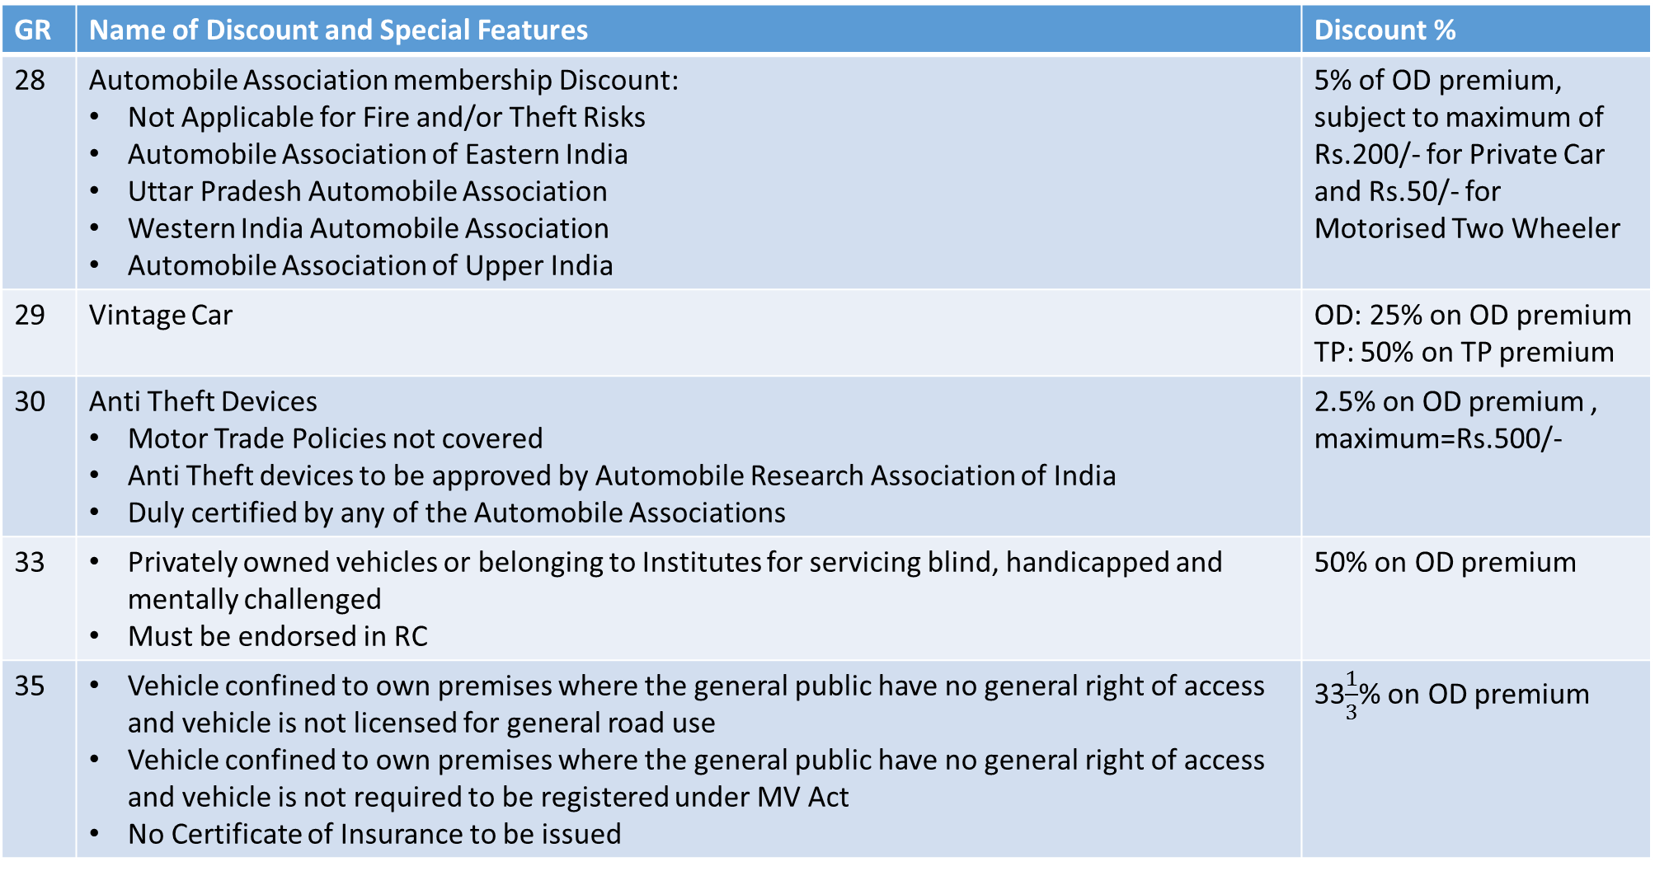
Tariff Concessions/Discounts
GR | Name of Discount and Special Features | Discount %
28 | Automobile Association membership Discount: Not Applicable for Fire and/or Theft Risks Automobile Association of Eastern India Uttar Pradesh Automobile Association Western India Automobile Association Automobile Association of Upper India | 5% of OD premium, subject to maximum of Rs.200/- for Private Car and Rs.50/- for Motorised Two Wheeler
29 | Vintage Car | OD: 25% on OD premium TP: 50% on TP premium
30 | Anti Theft Devices Motor Trade Policies not covered Anti Theft devices to be approved by Automobile Research Association of India Duly certified by any of the Automobile Associations | 2.5% on OD premium , maximum=Rs.500/-
33 | Privately owned vehicles or belonging to Institutes for servicing blind, handicapped and mentally challenged Must be endorsed in RC | 50% on OD premium
35 | Vehicle confined to own premises where the general public have no general right of access and vehicle is not licensed for general road use Vehicle confined to own premises where the general public have no general right of access and vehicle is not required to be registered under MV Act No Certificate of Insurance to be issued | 33$\frac{1}{3}$% on OD premium

Slide 32
GR 31
Vehicle laid up in garage and not in use
Concession for laid up vehicles can be offered to Liability Only Policy and Package Policy
For Package Policy, the coverage will be restricted to Fire and/or Theft during the period of lay up
Nature of concession:
A pro-rata return of premium for the laid up period will be credited to insured. The credited return of premium will be deducted from next renewal premium. Cash refund is not allowed.
OR
The expiry date of the current period of insurance under the policy may be extended for a period equal to the period the policy remained suspended on account of the lay up.

Slide 33
GR 31(cont.d)
Conditions for concessions under Vehicles Laid Up
Vehicles laid up in garage and not in use for a period of not less than TWO consecutive months
The vehicle is not undergoing repairs during lay-up as a result of an event giving rise to a claim under the policy
Previous notice in writing has been given to the insurer by recorded delivery
The certificate of insurance has been returned to the insurer
The period of lay-up / suspension of policy shall not extend beyond twelve months from the expiry date of the policy period in which the lay-up has commenced
The insured will be required to pay Rs.15/- towards administrative costs
Not applicable to trailers and vehicles used for hire or reward or for Motor Trade purpose, except when the permits for vehicles are temporarily withheld or suspended by the Government

Slide 34
GR 34
It is not permissible to insure any vehicle in the name of an insured not conforming to the name recorded as owner of the vehicle in the vehicle registration document, excepting
in case of temporary substitution
in respect of Motor Trade Risk, or
as provided in General Regulation 19, 20 and 21

Slide 35
GR 36A
The owner-driver of the vehicle is to be compulsorily given a PA cover, known as Compulsory Personal Accident (CPA) Cover for Owner-Driver
CPA cover is not applicable for Motor Trade Policies
Owner-Driver is the registered owner of the insured vehicle who holds a valid and effective DL
Cover is effective for Owner-Driver when:
He is driving the vehicle
He is mounting into or dismounting from the vehicle
Travelling in insured vehicle as a co-driver

Slide 36
GR 36A (Cont.d)
Cover:
100% of CSI for Death, Loss of Two Limbs or sight of both eyes or one limb and sight of one eye.
50% of CSI for Loss of one Limb or sight of one eye.
100% for Permanent Total Disablement from injuries other than named above.
provided the above occurs within six calendar months from the injury because of an accident
Section
Section II of Liability Only policy
Section III of Private Car Package Policy and Motorised Two Wheeler
Section IV of Commercial Vehicles Package Policy

Slide 37
GR 36B
Maximum Capital Sum Insured is Rs. 2 Lakhs per person
Private Cars including three wheelers rated as Private cars and motorized two wheelers with or without side car (not for hire or reward)
IMT 15 PERSONAL ACCIDENT COVER TO THE INSURED OR ANY NAMED PERSON OTHER THAN PAID DRIVER/ CLEANER, to be used - For insured or any named person other than the paid driver and cleaner, death or disability shall occur with 6 months from accident
IMT 16 PERSONAL ACCIDENT TO UNNAMED PASSENGERS OTHER THAN INSURED AND THE PAID DRIVER/ CLEANER, to be used - For unnamed passengers limited to the registered carrying capacity of the vehicle, death or disability shall occur with 3 months from accident

Slide 38
GR 36B (cont.d)
In respect of all classes of vehicles
IMT 17 PERSONAL ACCIDENT COVER TO PAID DRIVERS, CLEANERS AND CONDUCTORS, to be used - For paid drivers, cleaners and conductors, death or disability shall occur with 6 months from accident
In respect of Motorized Two Wheelers with or without side car (used for hire or reward)
IMT 18 PERSONAL ACCIDENT TO UNNAMED HIRER AND UNNAMED PILLION PASSENGERS, to be used – For unnamed hirer/ driver, death or disability shall occur with 3 months from accident

Slide 39
Developments in Compulsory Personal Accident for Owner-Driver
Minimum Sum Insured for owner-driver for all classes of vehicle is Rs. 15,00,000/-
A higher sum insured may be offered through optional covers. Higher Sum Insured may be in multiples of Rs.1,00,000/- or Rs. 5,00,000/-
For Long Term policies, insured has the option to go for annual CPA cover or long term CPA cover
Effective from 01.01.2019, Stand Alone Compulsory Personal Accident Cover for owner-driver may be issued
Insured has the option to choose CPA attached with Motor Policy or Stand Alone CPA
Coverage under Stand Alone CPA will extend to all vehicles owned by Owner-Driver under the same policy
Stand Alone CPA is an annual policy
If owner-driver already has a 24 hours Personal Accident Cover of 15 Lakhs, no separate CPA cover is required to be taken

Slide 40
GR 38
Vehicle requisitioned by Government are automatically held covered during the period of requisition without any additional premium
In the event of loss/damage during the period of requisition, the insurer shall pay the losses/liability in addition to the compensation by the government

Slide 41
GR 39
CLASS OF VEHICLES | TPPD COVER | Premium reduction if TPPD restricted to Rs. 6000/-
Private Cars | Rs. 7.5 Lakhs | Rs. 100
Commercial vehicles(excluding Taxis, Three wheelers and Motorised Two Wheelers-Commercial Vehicles | Rs. 7.5 Lakhs | Rs. 200
Commercial Vehicles(Three Wheelers and Taxis) | Rs. 7.5 Lakhs | Rs. 150
Motorised Two Wheelers and Motorised Two Wheelers (Commercial) | Rs. 1 lakh | Rs. 50
Mid term Change of TPPD limit is not permitted

Slide 42
Tarrif Loadings
GR | Details | Actionable
37 | Policy issued to cover imported vehicles belonging to Foreign embassies, High Commission and consulate where import duty is not included in IDV | Load premium by 30%
41 | Electrical and Electronic Items fitted in the vehicle but not included in MSP | Collect additional premium @4% on value of such fittings
42 | CNG/LPG fuel kit, where value of such fitment is known CNG/LPG fuel kit, where value of such fitment is not known | Collect additional premium @4% on the value of such kit Load OD premium by 5% Additional Rs. 60/- per vehicle to be charged towards Liability Only Cover
43 | Fibre Glass Fuel Tank | Rs. 100/- for Misc.D vehicles Rs. 50/- for all other classes of vehicles
44 | Vehicle used for driving tuition, having double clutches and brakes with accompanying professional tutor | OD section to be loaded by 60% For Two wheelers and Three wheelers, TP Premium shall also be loaded by 60%

Slide 43
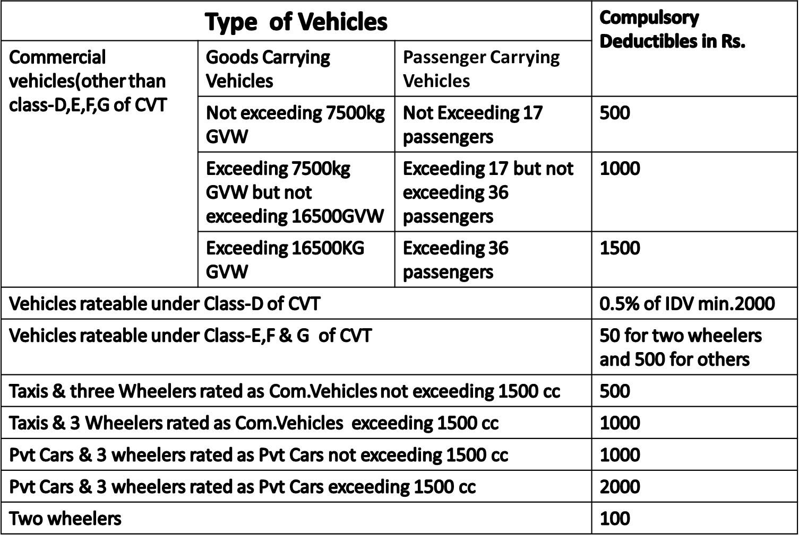
GR 40

Slide 44
IMT 21 and IMT 23
IMT 21 is used for application of compulsory excess for all commercial vehicles excluding Taxis and Motorised Two Wheelers
Special Exclusion:
Except in the case of Total Loss of the vehicle insured, the insurer shall not be liable under Section I of the policy for loss of or damage to lamps tyres tubes mudguards bonnet side parts bumpers and paint work.
Exclusions under (a) of Endorsement - 21 may be reinstated in cover by payment of additional premium @15% of the total gross OD premium (before application of any discount) and Endorsement -23 is to be used for such reinstatement of excluded cover. Besides, depreciation on these parts, Insured shall also bear 50% of the assessed loss in respect of each and every claim

Slide 45
GR 45A and GR 45B
Restricted covers are Fire and/or Theft AND Liability Only and Fire and/or Theft
Annual policies given to vehicle which will be in garage and not in use
Not to be allowed for Misc. D, E, F, G class of vehicles
Additional premium to be paid for:
Electrical and Electronic Fittings
CNG /LPG bi-fuel kit
Compulsory PA to owner/driver
Discounts may be granted if insured chooses to go for voluntary deductibles in respect of vehicles rateable under Private Car/two Wheelers
NCB not to be allowed for Fire and /or Theft risk. It is allowed for Liability Only and Fire and/or Theft Risk.

Slide 46
Minimum Towing Charges
Class of vehicles | Minimum Towing Charges
Private Car | Rs. 1,500/-
Two Wheelers | Rs. 300/-
Commercial Vehicles | Rs. 1,500/- for Taxis Rs. 750/- for Three Wheelers Rs. 2,500/- for other commercial vehicles

Slide 47
GR 47
Vehicles | Additional towing charges opted for over and above the limit prescribed in the policy | Premium chargeable on the additional amount opted for
Private cars | Upto Rs. 1,500/- | 5% on the additional amount opted
Two Wheelers | Upto Rs. 300/- | 5% on the additional amount opted
Commercial vehicles (Other than vehicles covered under Motor Trade Policies)
Two Wheelers and Three Wheelers | Upto Rs. 300/- | 5% on the additional amount opted
 | Upto Rs. 750/- | 5% on the additional amount opted
 | Exceeding Rs.750/- but not exceeding Rs.1,500/- | 7.5% on the additional amount opted
Taxis | Upto Rs. 1,500/- | 5% on the additional amount opted
 | Exceeding Rs.1,500/- but not exceeding Rs.3,000/- | 7.5% on the additional amount opted
Other Commercial Vehicles | Upto Rs. 10,000/- | 5% on the additional amount opted
 | Exceeding Rs.10,000/- but not exceeding Rs.20,000/- | 7.5% on the additional amount opted
Vehicles covered under Motor Trade policy | Upto Rs. 300/- | 5% on the additional amount opted
 | Exceeding Rs.300/- but not exceeding Rs.500/- | 7.5% on the additional amount opted

Slide 48
Section-2, Private Car
Social, domestic and pleasure purpose. Also professional purpose.
professional purpose-includes purpose of travel by Insured or use by Insured’s employees.
Professional purpose-excludes carriage of goods other than samples.
Private Car Type Vehicles
Motorised Three Wheeled-cabin body scooters/rickshaws-motorized
750cc-1000cc to be rated as 1000cc PC
<750 cc to be rated as PC with 50% OD discount.

Slide 49
Section-2, Private Car (Cont.d)
Rating Factors:
IDV
Cubic Capacity
Geographical Zones-
Zone A: Ahmedabad, Bangalore, Chennai, Hyderabad, Kolkata, Mumbai, New Delhi and Pune
Zone B: Rest of India
4. Age of the vehicle

Slide 50
Section-2, Private Car (Cont.d)
Extension to cover rallies
Compulsory Deductible will become-Rs.5000/-
This extension does not cover either driver and/or the passengers carried in the vehicle or the promoters event.
Extension could not be extended to cover speed tests, dexterity trials, hill climbs or motor racing (whether organized separately or included in the course of rally).
Rally extension loading of 300% of both OD and TP premium at short period rates.
Reliability trials cannot be covered and reference to be made to TAC for these.
the estimated cost of such repair including replacements, if any, does not exceed
Rs.500/-;

Slide 51
Section-3, Two Wheelers
Social, domestic and pleasure purpose. Also professional purpose.
professional purpose-includes purpose of travel by Insured or use by Insured’s employees.
Professional purpose-excludes carriage of goods other than samples.
Rating factors:
Rating Factors:
IDV
Cubic Capacity
Geographical Zones-
Zone A: Ahmedabad, Bangalore, Chennai, Hyderabad, Kolkata, Mumbai, New Delhi and Pune
Zone B: Rest of India
4. Age of the vehicle

Slide 52
Section-3, Two Wheelers (Cont.d)
Loss of accessories –covered at Additional premium of 3% of value of accessories-specifically declared by Insured in proposal form.
Minimum premium of Rs.50 for covering loss of accessories is to be charged.
Loss of or damage to accessories by burglary housebreaking or theft unless vehicle is stolen at the same time.
Use of Side Car-exclusive to TW in limitations as to Use.
the estimated cost of such repair including replacements, if any, does not exceed Rs.150/-
Extension to cover rallies
Compulsory Deductible will become-Rs.2500/-

Slide 53
Section-4, Commercial Vehicles
Commercial Vehicles
Goods Carrying Vehicles:
A1:Public Carriers - other than 3 wheelers
A2:Private Carriers - other than 3 wheelers
A3:Public Carriers - 3 Wheeler & Motorised Pedal Cycles
A4:Private Carriers - 3 Wheeler & Motorised Pedal Cycles
Trailers
Vehicles used for Carrying Passengers for Hire or Reward
C.1 – (b)3 /(a) 4 wheeler Vehicles - not exceeding 6 passenger
C.2 - 4 (or more) wheeled PCV with > 6 passengers and 3 wheeled PCV >17 passengers
C.3 - Motorized 3 wheeled PCV > 6 passengers but not exceeding 17 passengers
C.4 - two wheelers PCVs
Miscellaneous and Special Type of Vehicles
Motor Trade – Road Transit Risks only
motor Trade – Road Risks only
Motor Trade – Internal Risks only

Slide 54
Section-4, Commercial Vehicles (Cont.d)
Rating Factors
IDV
Zones (other than C1 and C4)
Zone A: Kolkata, New Delhi/Delhi, Mumbai, Chennai
Zone B: All other State Capitals
Zone C: Rest of India
Age of the vehicle
GVW/Licensed carrying Capacity

Slide 55
Section-4, Commercial Vehicles (Cont.d)
Quadricycle-introduced in 01.06.2018
Specifications- less than equals to 475 kg for PCV
less than equals to 550 kg for GCV
Separate TP rates have been introduces in 2019
E-Cart- Specs-310 Kg-rated in A3 and A4
E-Rickshaw-Specs-4 passengers, 40Kg luggage-rated in C1b
Both are less than equals to 4000Wah
the estimated cost of such repair including replacements does not exceed Rs.500/-
Limitation of Geographical Area-Motor trade Policies

Slide 56
Section-4, Commercial Vehicles (Cont.d)
Miscellaneous Vehicles-other than below mentioned, rest all miscellaneous vehicles covers hire or reward:
Agricultural and Forestry vehicles.
Mobile shops and canteens
Cinema Film Recording and publicity vans
Delivery trucks
Pedestrian controlled trolleys
Vehicles used for driving tuition
Fire Brigade and Salvage Corps
If these are also to be included with hire or reward, loading of 25% on premium is to be done.

Slide 57
Special Provisions - Miscellaneous Vehicles
Following Class D – Misc Class of Vehicles had been reclassified and to be rated as GCCV–Goods Carrying Commercial Vehicles (w.e.f. 30.03.2012) under Section 4A
• Non Agricultural Tractors used as GCCV
• Dumpers
• Milk Vans
• Oil and Petroleum Transport Vehicles.
• Refrigeration / Pre cooling Units.
• Tankers.
• Tippers
• Electric Trolleys or Tractors
• Traction Engine Tractors
• Trolleys and Goods Carrying Tractors.

Slide 58
Special Provisions under Misc. D vehicles
To cover overturning risk, additional premium @0.5% of IDV is required to be charged for the following vehicles (subject to minimum additional premium of Rs.100/-)[IMT 47]:
Mobile Cranes
Mechanical Navies, Shovels, Grabs, Rippers and Excavators
Dragline Excavators
Mobile Drilling Rigs
Mobile Plant

Slide 59
Long Term Policies with effect from 01.09.2018
Result of order dt: 20.07.2018 by Supreme Court for “Shri.S.Rajaseekaran vs Union of lndia and Ors”
IRDAI mandated that for new vehicles, insurance companies must offer with effect from 01.09.2018:
Liability Only cover – Three years for Private Cars and Five Years for Two Wheelers
Package Cover
(a) Both Long Term for OD section and TP Section : Long Term Package Policy
(b) Annual OD Section and Long Term TP section: Bundled Cover
Long Term Products are not to be offered for renewal of existing policies or old vehicles
With effect from 01.09.2019, issuance of bundled policy is not compulsory and instead Stand Alone OD policy along with Long Term Liability policy may be offered
With effect from August 1st, 2020, Long Term Package Policies for new vehicles are withdrawn by IRDAI

Slide 60
Stand Alone OD policy
Insured may choose to obtain Long Term Liability cover along with a Stand Alone OD policy
Stand Alone OD policy is for twelve months only
To issue Stand Alone OD policy, there must be a Liability cover in existence at the time of inception of SAOD.
The OD portion of an already issued Bundled Cover may be renewed by Stand Alone OD policy
Stand Alone OD policy is being offered w.e.f 01.09.2019

Slide 61
Thank You

